Slide 1
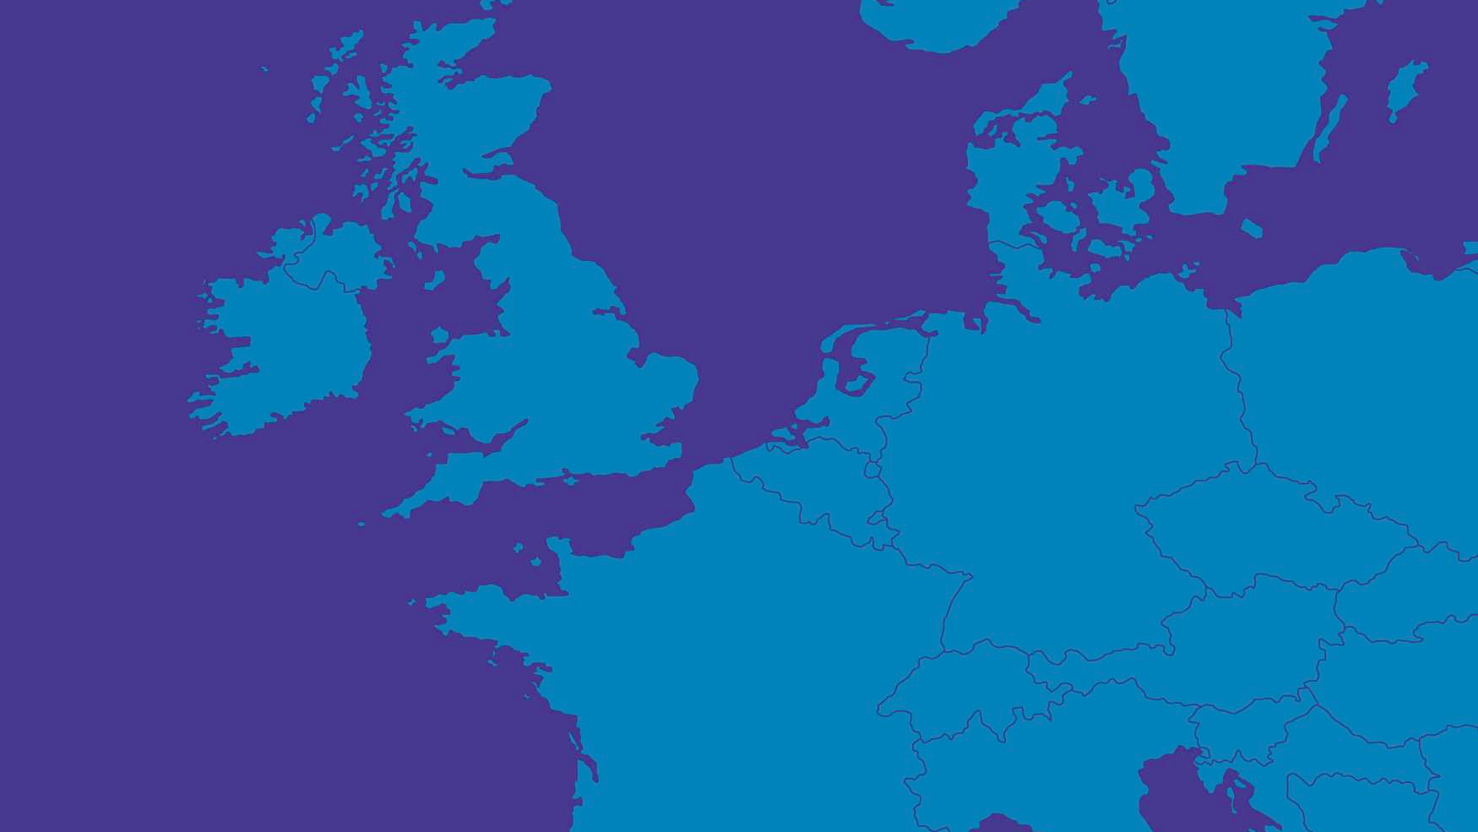

European System Needs 2040
&
Regional Investment Plans

Slide 2
INTRODUCTION
Laurent Schmitt – Secretary General

Slide 3
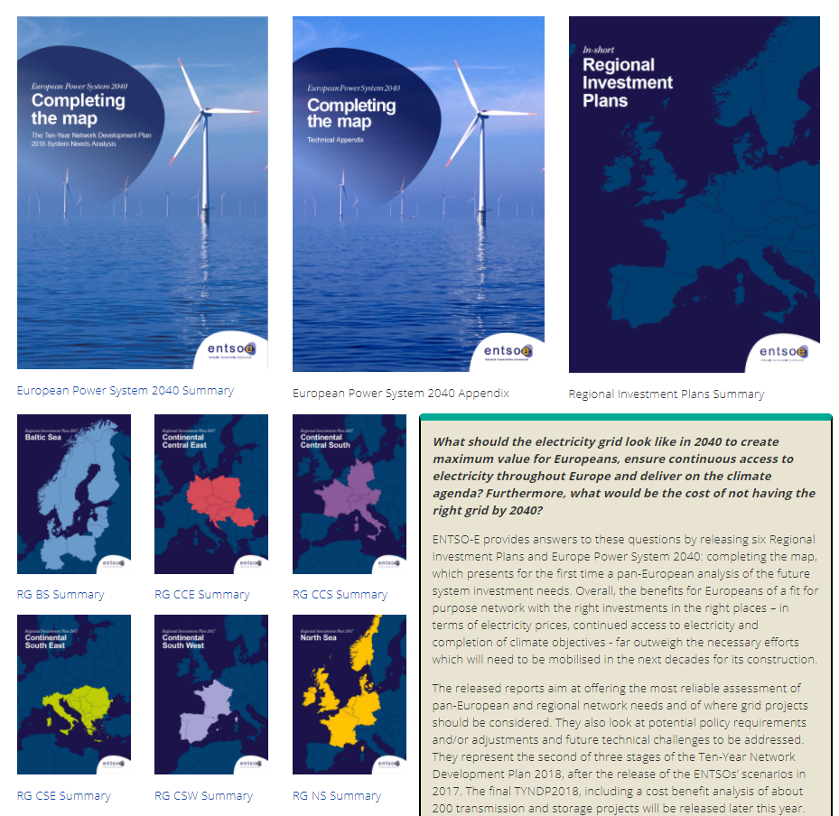
European Power System 2040
Package
Click the covers to access the full documents
Click the link under the cover to access the summaries
Link to SITE

Slide 4
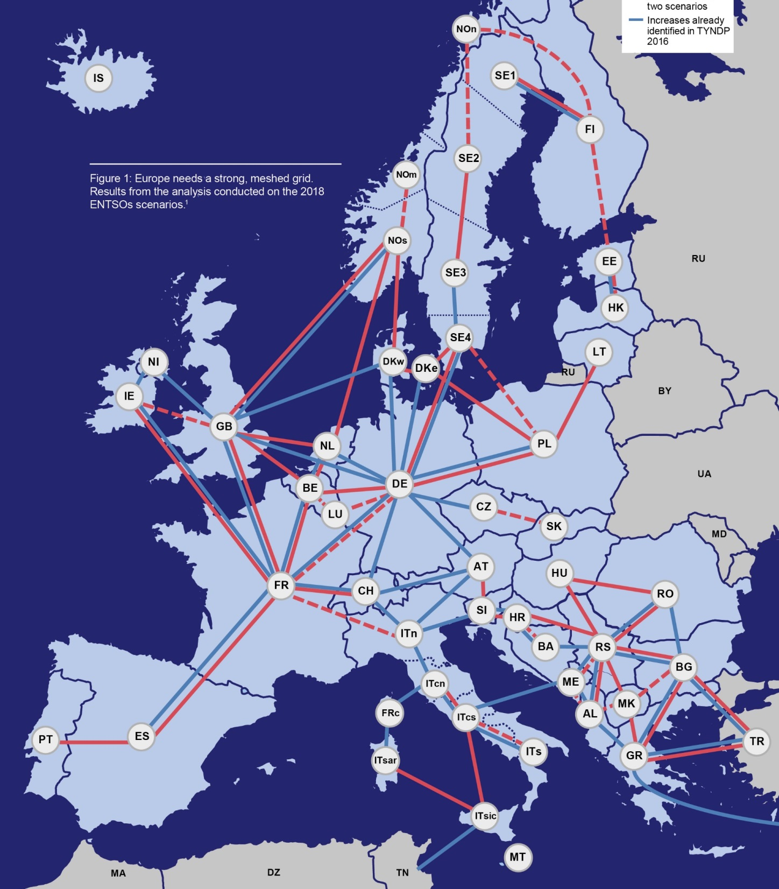
European System Needs 2040
Methodology

Slide 5
Identification of the System Needs Methodology
Agenda
Introduction
References: data and modelling
Approach used
General results

Slide 6
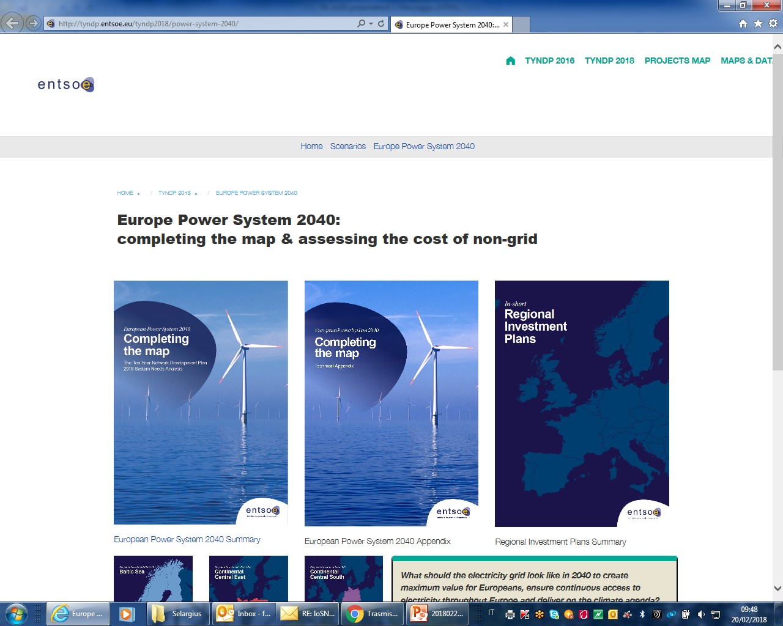
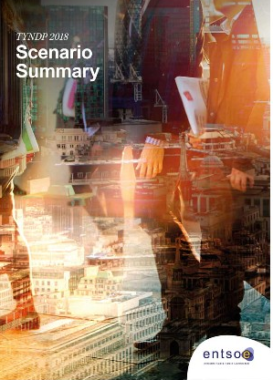
Identification of the System Needs Methodology
The general process of TYNDP
Scenario building process
All reference scenarios used for all analysis performed
Identification of System Needs in 2040
New capacity increases
CBA
To evaluate the impact of planned network reinforcements
would be necessary by 2040.
TYNDP 2018

Slide 7
Identification of the System Needs Methodology
Purpose of the study and main conclusions
What should the electricity grid look like in 2040 to create maximum value for Europeans, ensure continuous access to electricity throughout Europe and deliver on the climatic agenda?
New investment needed after 2030
  need for increased transmission capacity in some places to make the system work in 2040.
  new interconnection across and between all regions, largely due to the increasing levels and use of renewable resources
  internal reinforcements of the grid will also be necessary in most European countries.
  6 months of study
  3 tools used for market study
  4 tools used for network study
  Hundreds of simulations performed
  All TSOs involved in the analysis and the discussion of the results

Slide 8
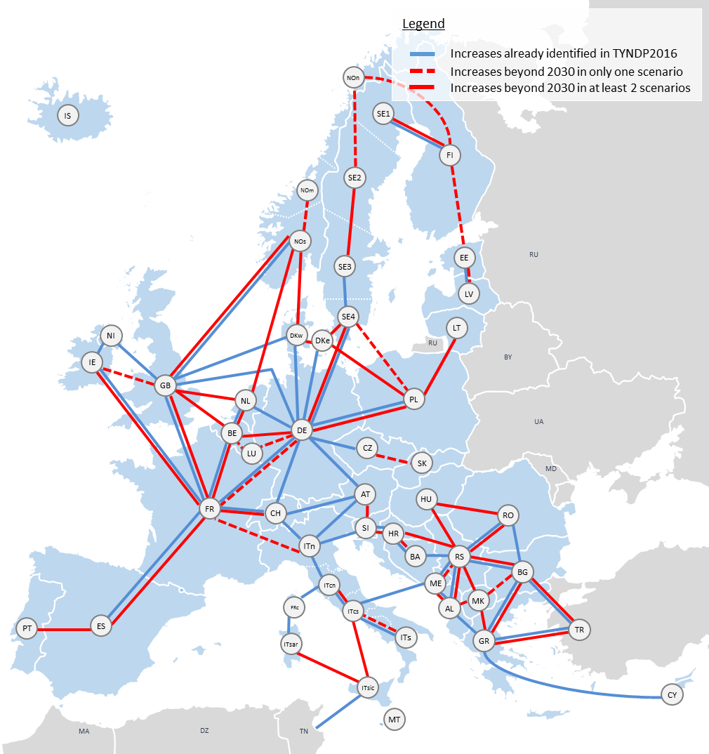
Identification of the System Needs Methodology
Summary of results
For three distinct 2040 scenarios, which European borders presented the highest economic gains when equipped with an additional interconnector (using standard development costs for each border).
The results of this analysis is a set of proposed capacity increases per European border, and an
indication of the need they respond to (economic,
security of supply or RES).

Slide 9
Identification of the System Needs Methodology
Agenda
Introduction
References: data and modelling
Approach used
General results

Slide 10
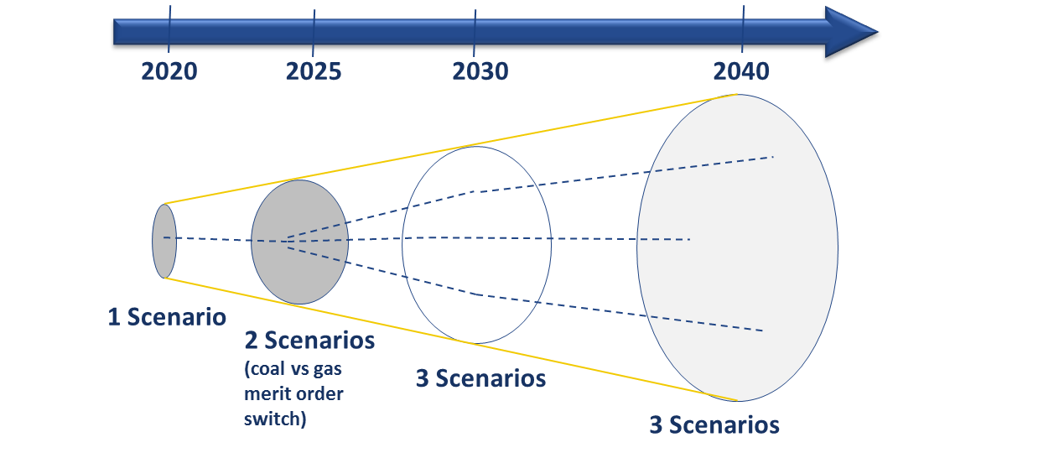
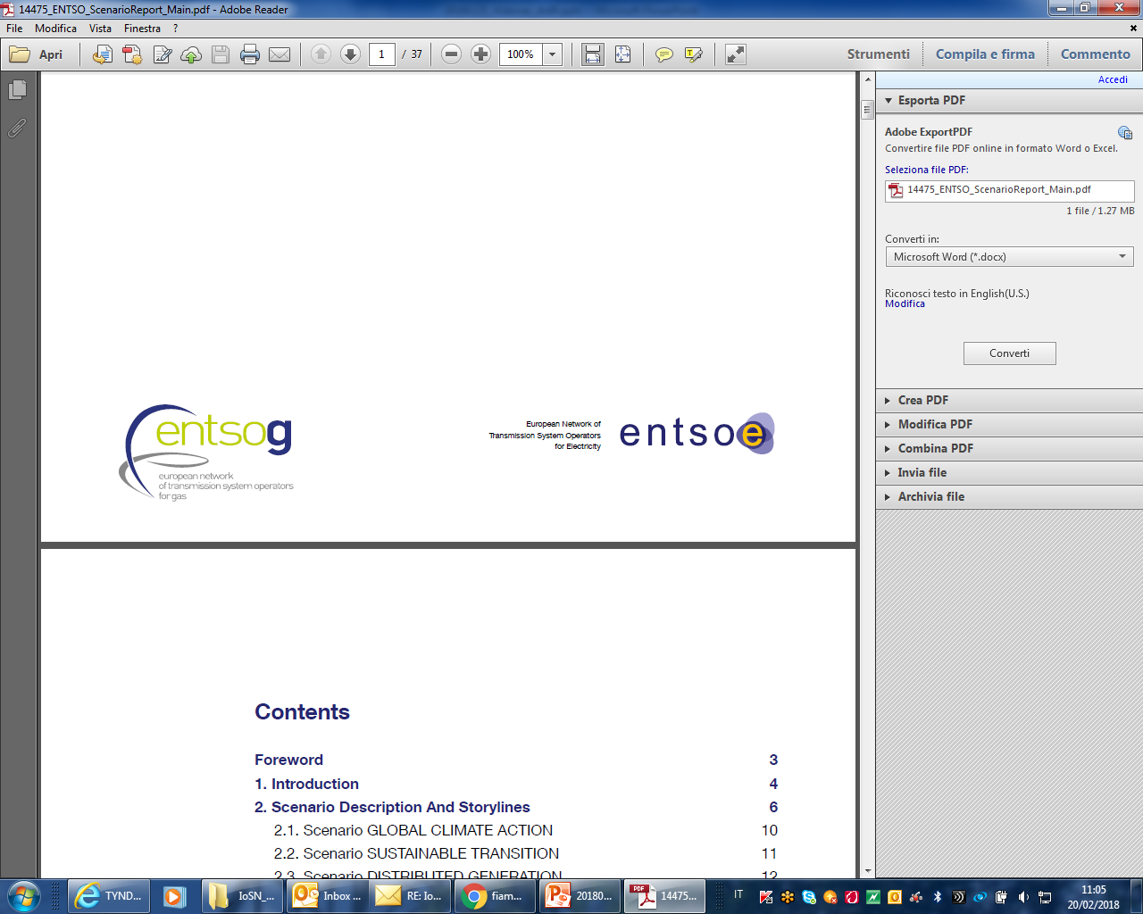
Identification of the System Needs Methodology
Scenario used in TYNDP process
Main update respect the TYNDP 2016
Cooperation with ENTSOG
Publication of Clean Energy Package
Key factors:
  Transport
  Heating
  Power
  Renewable Gases

Slide 11
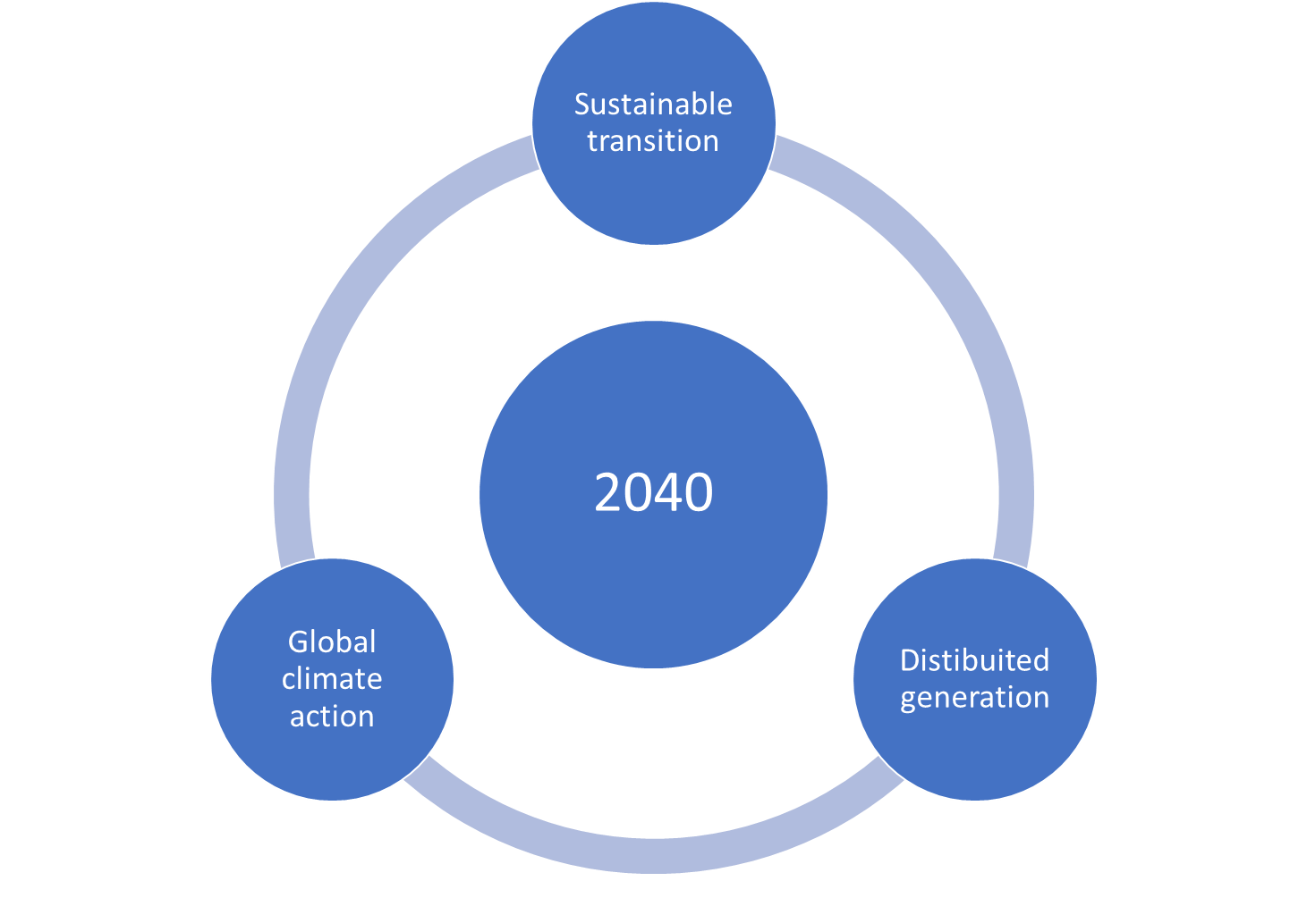

Identification of the System Needs Methodology
2040 scenario considered
Main update respect the TYNDP 2016
3%
53%
Full consistency with the data considered in scenario report published for consultation
Status
Consulted between 2/10 and 11/11.
Under preparation the final release
Total electricity renewables
11%
75%
7%
65%
Total gas renewables

Slide 12
Perimeter
34 countries modelled
5 countries modelled by more than one market area
Modelling
The/hyd optimization
RES generation based on Climate conditions
Approach
Deterministic simulation
Market and network analysis combined
Identification of the System Needs Methodology
System Model considered
Data and parameters fully discussed and analyzed by all TSOs
Main update respect the TYNDP 2016
Additional internal nodes included
Turkey and Malta already included
Demand side response
Price band for OTH generation
3 climate conditions considered (clustering analysis)

Slide 13
Identification of the System Needs Methodology
Agenda
Introduction
References: data and modelling
Approach used
General results

Slide 14
Identification of the System Needs Methodology
Main steps of the approach
Market studies
Identification of potential needs based on marginal costs diff. and the cost of capacity incr.
Check of economic efficiency
Network studies
Identification of cross border and internal bottlenecks
Update of costs of capacity increase
Regional
expert check
Integration of renewable generation
Check of interconnection targets
Reduction of risk of SoS issue
Main update respect the TYNDP 2016
Better balance between overall EU view and RGs specificity
Additional capacity increases not necessarily result in new projects in TYNDP 2018

Slide 15
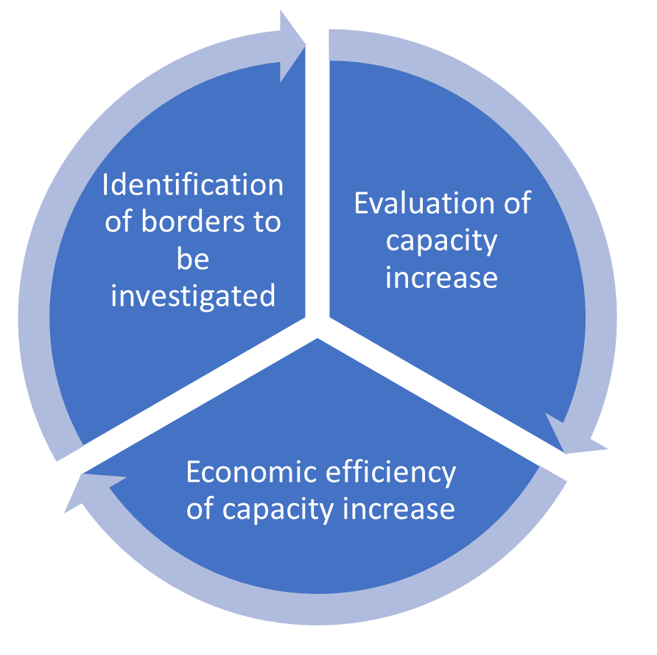
Identification of the System Needs Methodology
Market Study
Highest factor of marginal cost difference divided by standard cost of an increase
Social Economic Welfare evaluation
Starting point
Tools used
2030 reference capacity
PowrSym
BID
Antares
Standard cost for capacity increase
Climate conditions considered
Defined for all borders
Based on the expert view of all TSOs
1982
1984
2007
Comparison between benefit and cost of simulated capacity increase

Slide 16
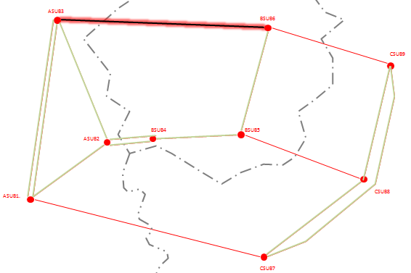
Identification of the System Needs Methodology
Network Study
standard costs based on expectations
Market Iterations
Market Outputs
(common template)
Update of costs based on bottlenecks screening
8760 Load flows
Project candidate
Bottlenecks screening

Slide 17
3 tools covering the continental Europe:
- Convergence
- Integral 7
- PSS\E
Goal is to have physical flows on all the tie-lines of the perimeter.
Regional experts covering smaller perimeters.
Goal is to have screening of bottlenecks on tie-lines and internal lines of a region.
Sensitivities, using of PST, further HVDC settings, deeper analysis are elaborated within these regional groups of expertise.
Identification of the System Needs Methodology
Network Study
Physical flows on tie-lines
as limit conditions of smaller perimeters

Slide 18
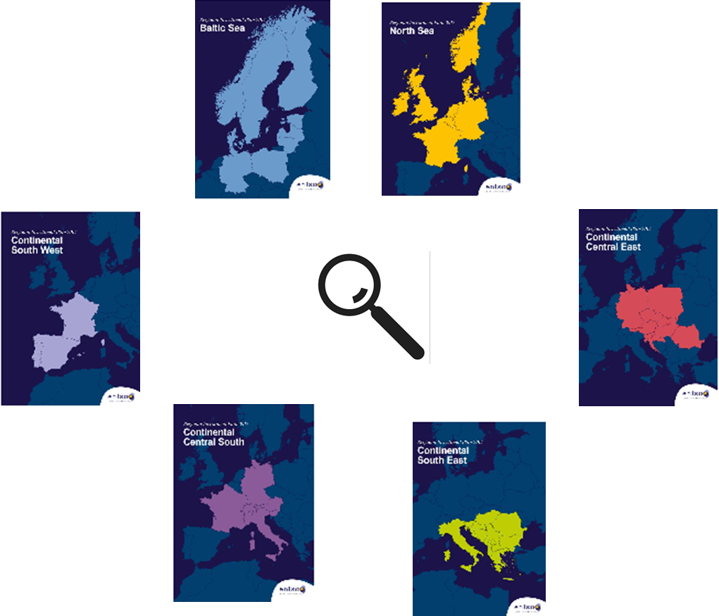
Identification of the System Needs Methodology
Regional expert check
- Pan EU models cannot replicate in detail all Regional specificities
- National target for RES integration and SoS can be different
Regional experts on the base of the results provide indication to adress further check and analysis

Slide 19
Identification of the System Needs Methodology
Agenda
Introduction
References: data and modelling
Approach used
General results

Slide 20
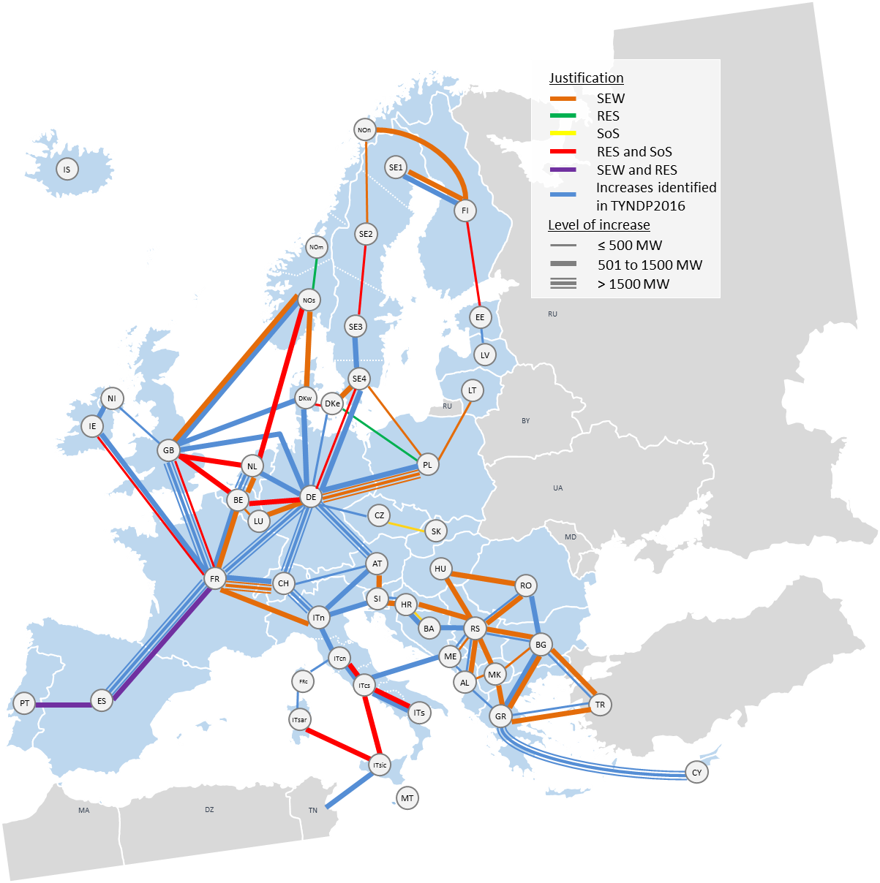
Identification of the System Needs Methodology
Increases from 2020 to Scenario Grid “Global Climate Action 2040”
Scenario key factors:
Global emissions trading scheme
Large scale development of renewable resources. Low Carbon technologies.
High economic growth & Energy Efficiency
Electric and gas vehicles displace oil in the private transport sector
Gas helps the decarbonisation of the shipping and heavy good transport sectors
Power-to-gas commercially available. Bio-methane
Electric and hybrid heat pump technology help to decarbonise heating

Slide 21
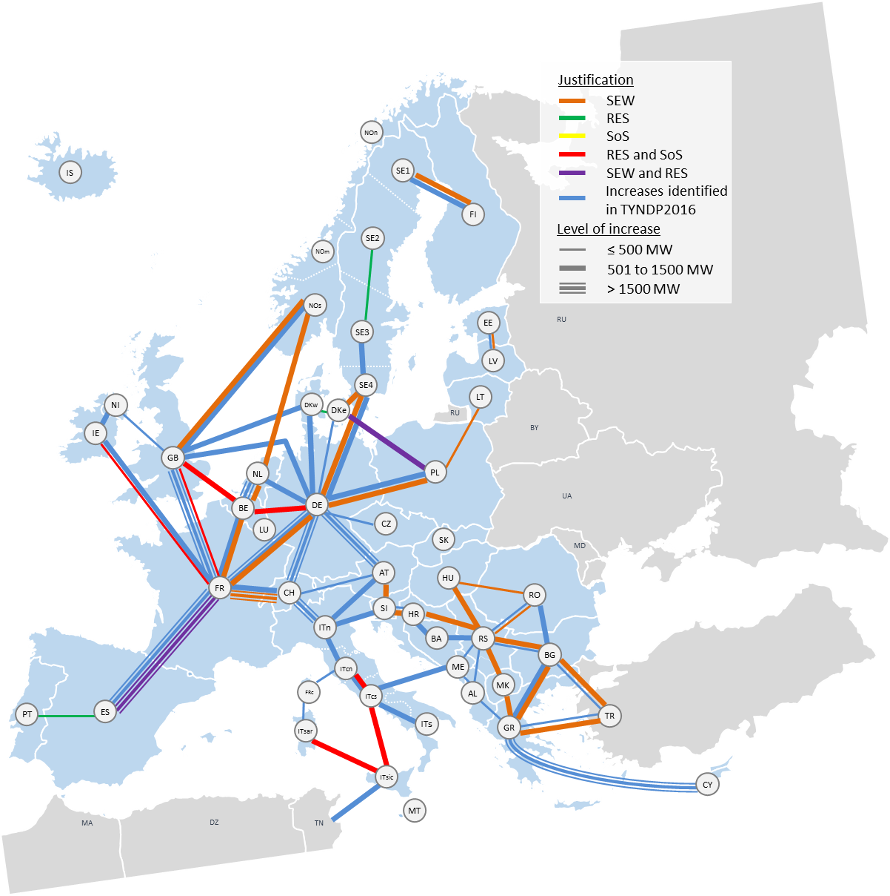
Identification of the System Needs Methodology
Increases from 2020 to Scenario Grid “Distributed Generation 2040”
Scenario key factors:
‘Prosumer’ lead climate action, helped by strong EU Policies and an efficient ETS.
Storage drives climate action
Decentralised growth of renewable resources
High economic growth
Smart cities enabled with electricity storage and demand response
Decarbonisation of transport driven by electric vehicles
Hybrid heat pumps offer consumer choice and flexibility

Slide 22
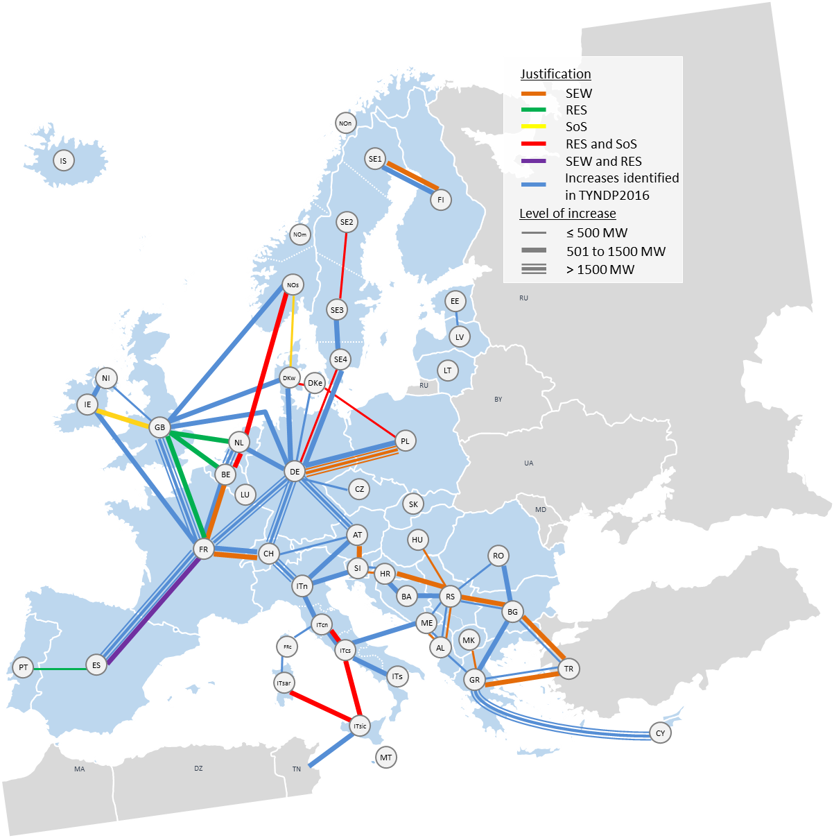
Identification of the System Needs Methodology
Increases from 2020 to Scenario Grid “Sustainable Transition 2040”
Scenario key factors:
National focus on climate change, driven by ETS and national subsidies
Steady growth of renewable resources
Moderate economic growth
Gas sees significant growth in the shipping and transport sectors
Electrification of heating and transport sees stable development
Strong development in Bio-methane but none in Power-to-gas
Heat pump technology most common in new buildings

Slide 23
Identification of the System Needs Methodology
Additional analysis performed
System dynamic and operational challenges
Flow based market model approach tested
Intercon.
target check
All analysis are the base to improve continuously the data and the methodology

Slide 24
Thank you for attention
Fabrizio Vedovelli
TYNDP 2018 Market Study team

Slide 25
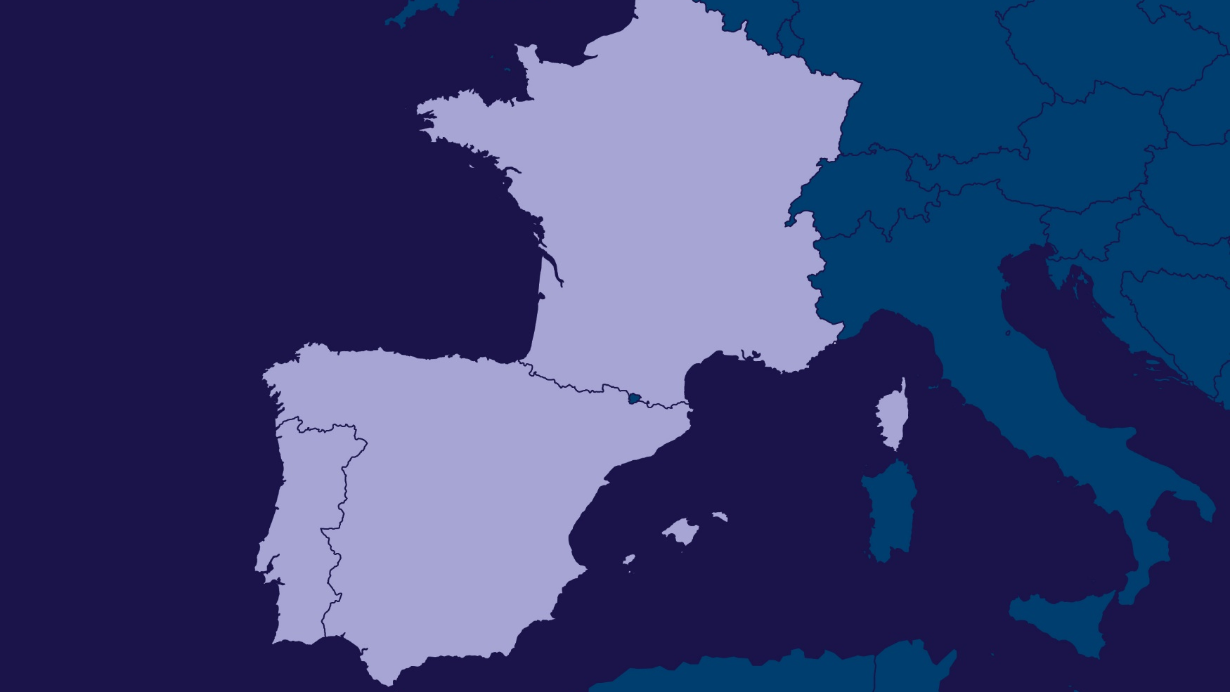
CSW
Patricia Labra
Convenor RG Continental South West

Slide 26
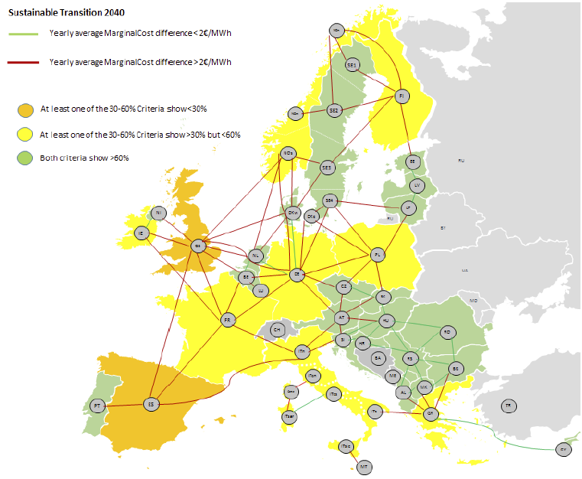
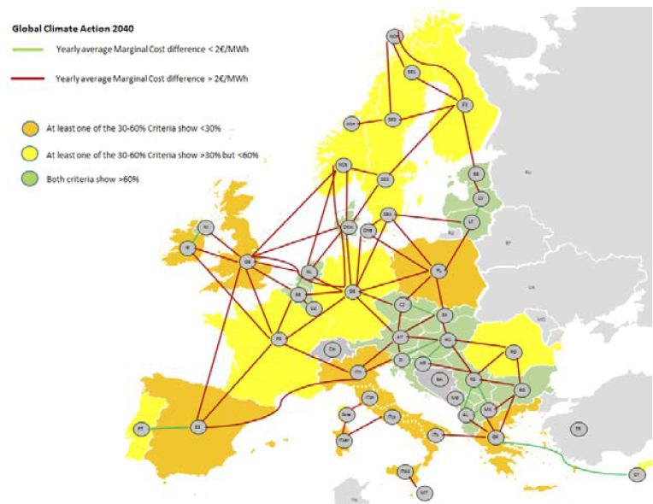
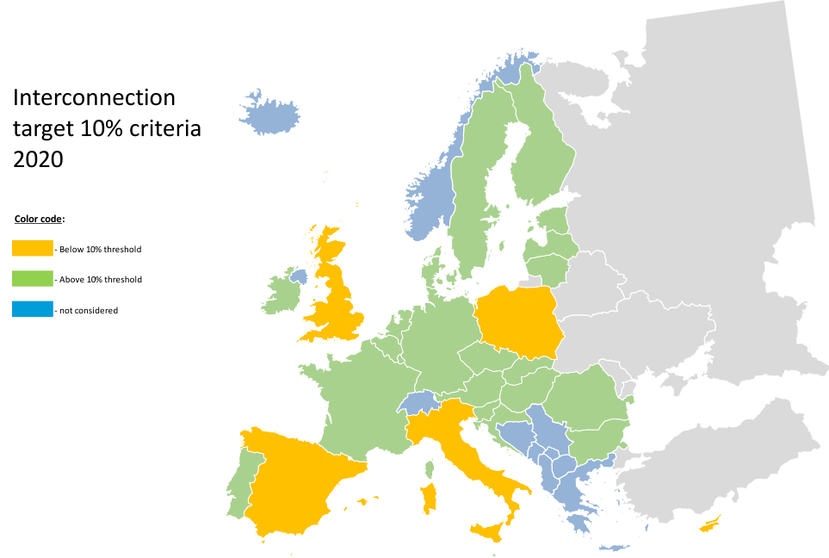
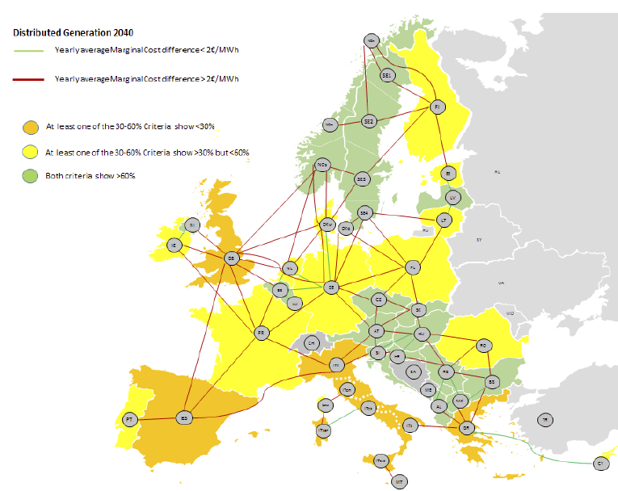
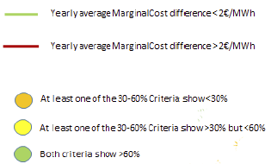
Main challenges of the region
Need for further market integration
Insufficient cross-border capacity:
  Completion of MIBEL
  Integration of Iberian Peninsula to the European continental market
Proposal of Interconnection Target Expert Group applied to 2040
Sustainable Transition 2040
Global Climate Action2040
Distributed Generation 2040
Notes:
The need for further market integration in the region is still something to resolve, and will go on to be an issue in the future.
and 2030 interconnection targets also provide signals to analyse additional connections beyond planned projects.
In 2020, Spain won’t yet fulfill the 10% objective for 2020 in spite of the strong efforts of TSO’s and the support from Member States and EC through the Madrid Declaration and the High Level Group monitoring.The current analysis also shows some additional needs in the 2040 horizon related to cross border development, especially in reinforcing the Iberian Peninsula with the rest of continental Europe that should be carefully analyzed in the future.

Slide 27
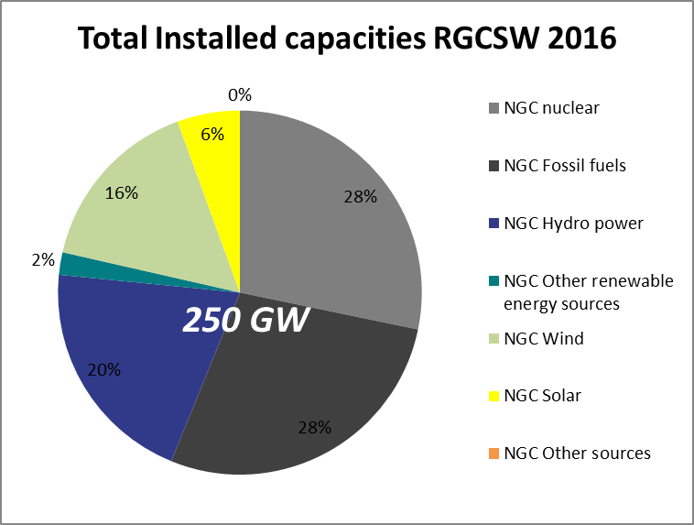
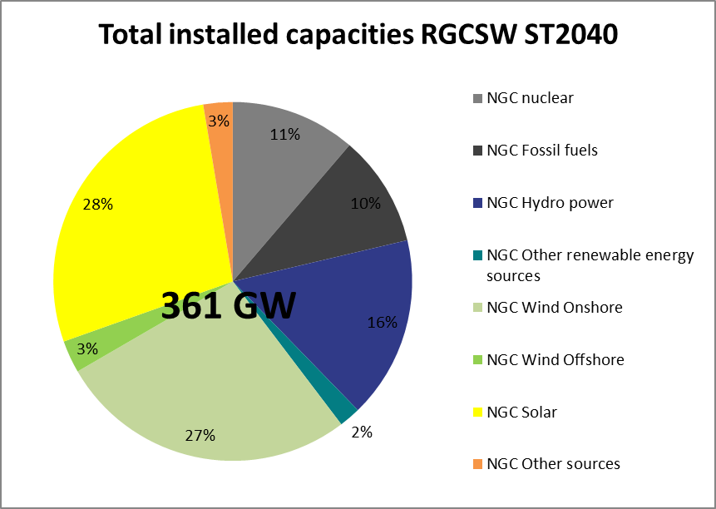
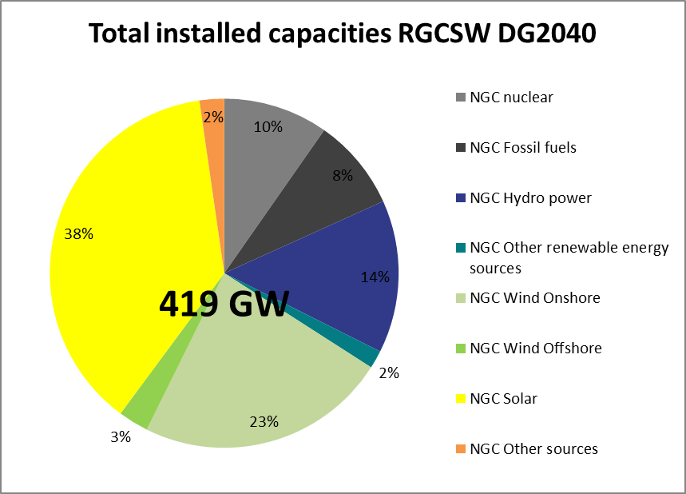
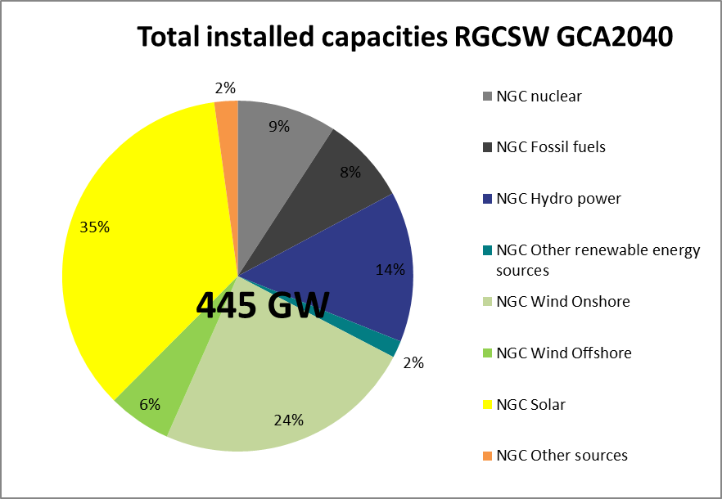
Main challenges of the region
RES integration (solar and wind):
  From a 22% of total installed generation in 2016 to a range of 58%-65% in 2040
Notes:
Under the considered scenarios, the region will experience an important change in the generation portfolio towards a more carbon-free system
A shift from coal to gas generation (cf. scenario report), and a shift from thermal to renewable generation, including the partial phase out of nuclear in France.
The optimization of RES performed in the 2030 and 2040 top down scenarios led to the assignment to the CSW region a massive increase of RES, mainly solar in the Iberian Peninsula (based on its high potential) and France, in addition to a significant increase of wind specially in France, even offshore wind, and other RES technologies in the region
— The RES integration will be an issue to tackle and it will not have a unique solution.

Slide 28
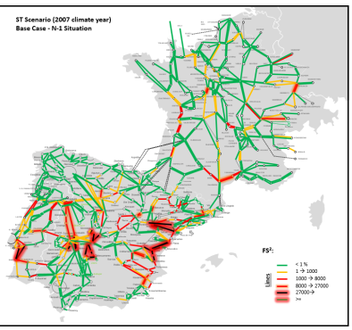
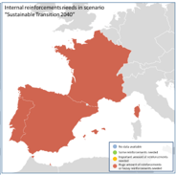
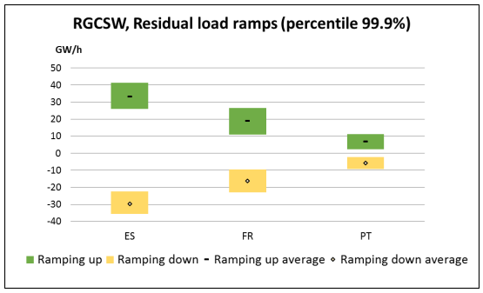
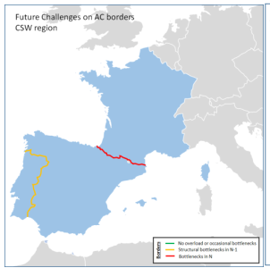
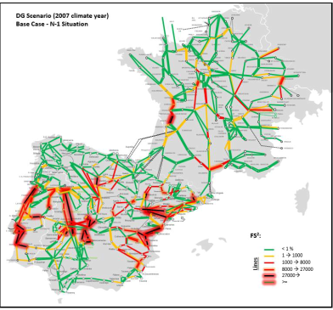
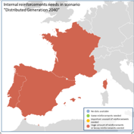
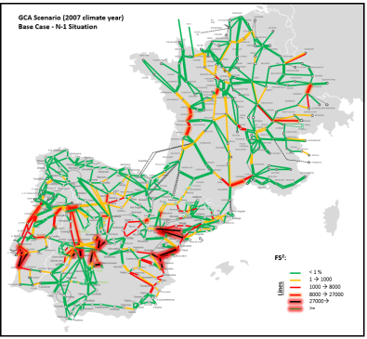
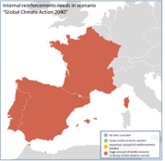
Main challenges of the region
The system will experience new power flow patterns and important investment needs
The security of supply will have a new diemension: higher needs for flexibility, inertia, dynamic issues...
Values 4-5 times higher than current values
Notes:
The regional system will experience wide area power flows and also new power flow patterns for which the existing grid was not designed, and therefore congestions can appear
If these long-term scenarios materialize, cross border and important internal reinforcements from today grid will be needed to make the grid safe.
Those reinforcements solving congestions that are common to the three analyzed scenarios will have more probability to be part of the National Development Plans of the next decades. However, it is too soon for defining in a detailed way the reinforcements needed due to the identified 2040 cross-border capacity needs, as the volumes of RES and correct location of generation in the CSW region should be more certain.
— The security of supply will have a new dimension, with issues related to flexibility, dynamic issues and system Inertia and Demand Side Response will gain importance in the security of suply

Slide 29
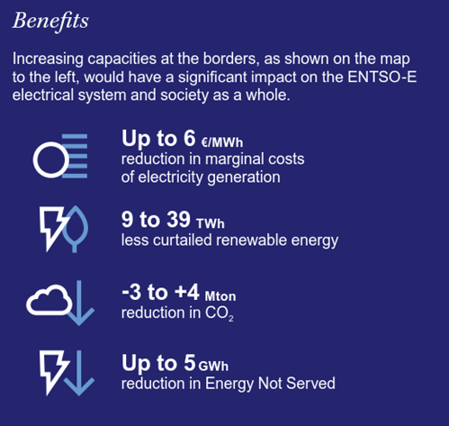
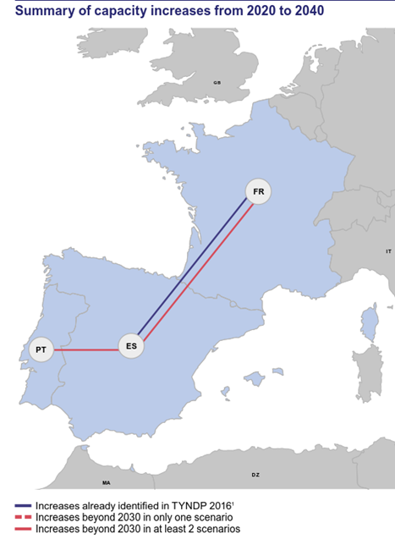
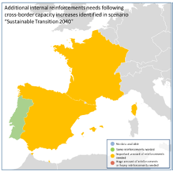

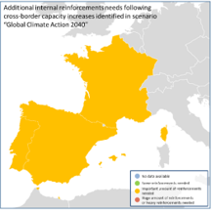
Future capacity needs identified
Summary of capacity increases 2020-2040
2040
Today
9000-10000 MW
4000-5700 MW
*ES-PT Northern interconnection was considered as commissioned in 2020 and it is not included as increases (in blue colour).
Impact of identified capacity increases on internal grid reinforcement needs in the three studied 2040 scenarios
Notes:
These challenges are reflected in the identified grid development needs for 2040.
The increase of cross-border exchange capacities in Europe from 2020 on would have a significant impact on the electrical system and the society as a whole
-They would reduce the annual average marginal cost in France, Spain and Portugal in a range between 2 to 6€/Mwh
- They would allow to integrate from 9,000 to 39.000 GWh of renewable energy as maximums in the CSW region, that otherwise would be curtailed
- They would allow an overall reduction of CO2 in Europe that in the region vary from an increase up to 3.000 ktons of CO2 to a reduction up to 4.000 ktons of CO2 emissions. Increases in CO2 emissions are produced in the sustainable transition scenario, where a moderate increase on renewable sources is considered and consequently, CSW region exports a high amount of energy from gas sources
They would allow up to a 5 GWh reduction in Energy not served in the region
Although the quantified benefits for the CSW region presented in this report result from the Europe-wide increase of cross-border capacities, the role of capacity increases inside the CSW region on Portugal-Spain border and France-Spain border is of course essential to form the major part of these benefits.
It is not trivial to separate the constraints that are due to the capacity increases in this exercise from those that are associated to RES integration, as many of them are very interrelated when the increase of cross border flows is due to higher RES production.

Slide 30

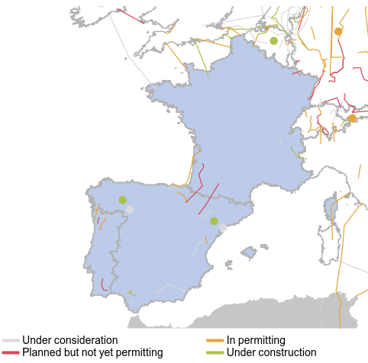
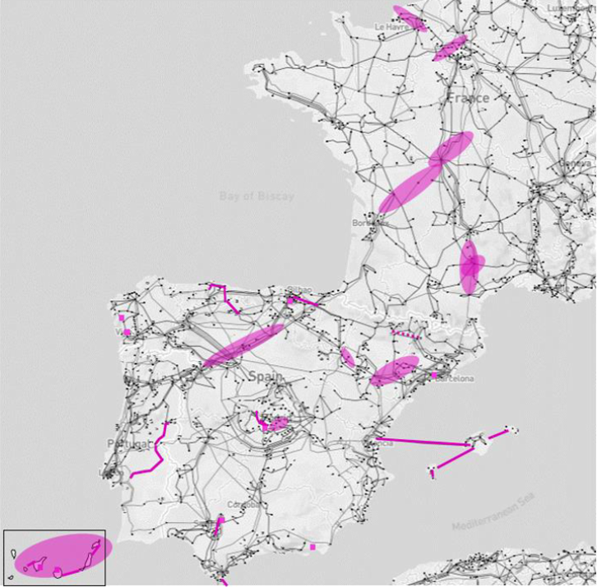
Projects to be assessed with CBA methodooly
4 Cross-border projects:
  Northern interconnection between ES-PT
  Biscay Gulf project between ES and FR
  Navarra-Landes project between ES and FR
  Aragon- Pyrenees Atlantiques project between ES and FR
12 internal projects (9 in ES and 3 in PT)
4 Storage projects in ES
... And projects of Regional significance
Notes:
8 in France
19 in Spain
2 in Portugal
Beyond these projects, there are still some gaps with the 2040 scenario capacities obtained in the Identification of system needs, especially in the Spain-France border. Its analysis still needs to be investigated in future releases of the TYNDP. By now it is not robust enough, so it seems too soon to propose any additional project in this border.
In addition any proposal need to cope with the evolution of already planned projects, as there would be interactions among them. To summarize, some future additional projects could be considered in the future in case the trends identified in the scenarios are confirmed in the coming years

Slide 31
Thank you for attention

Slide 32
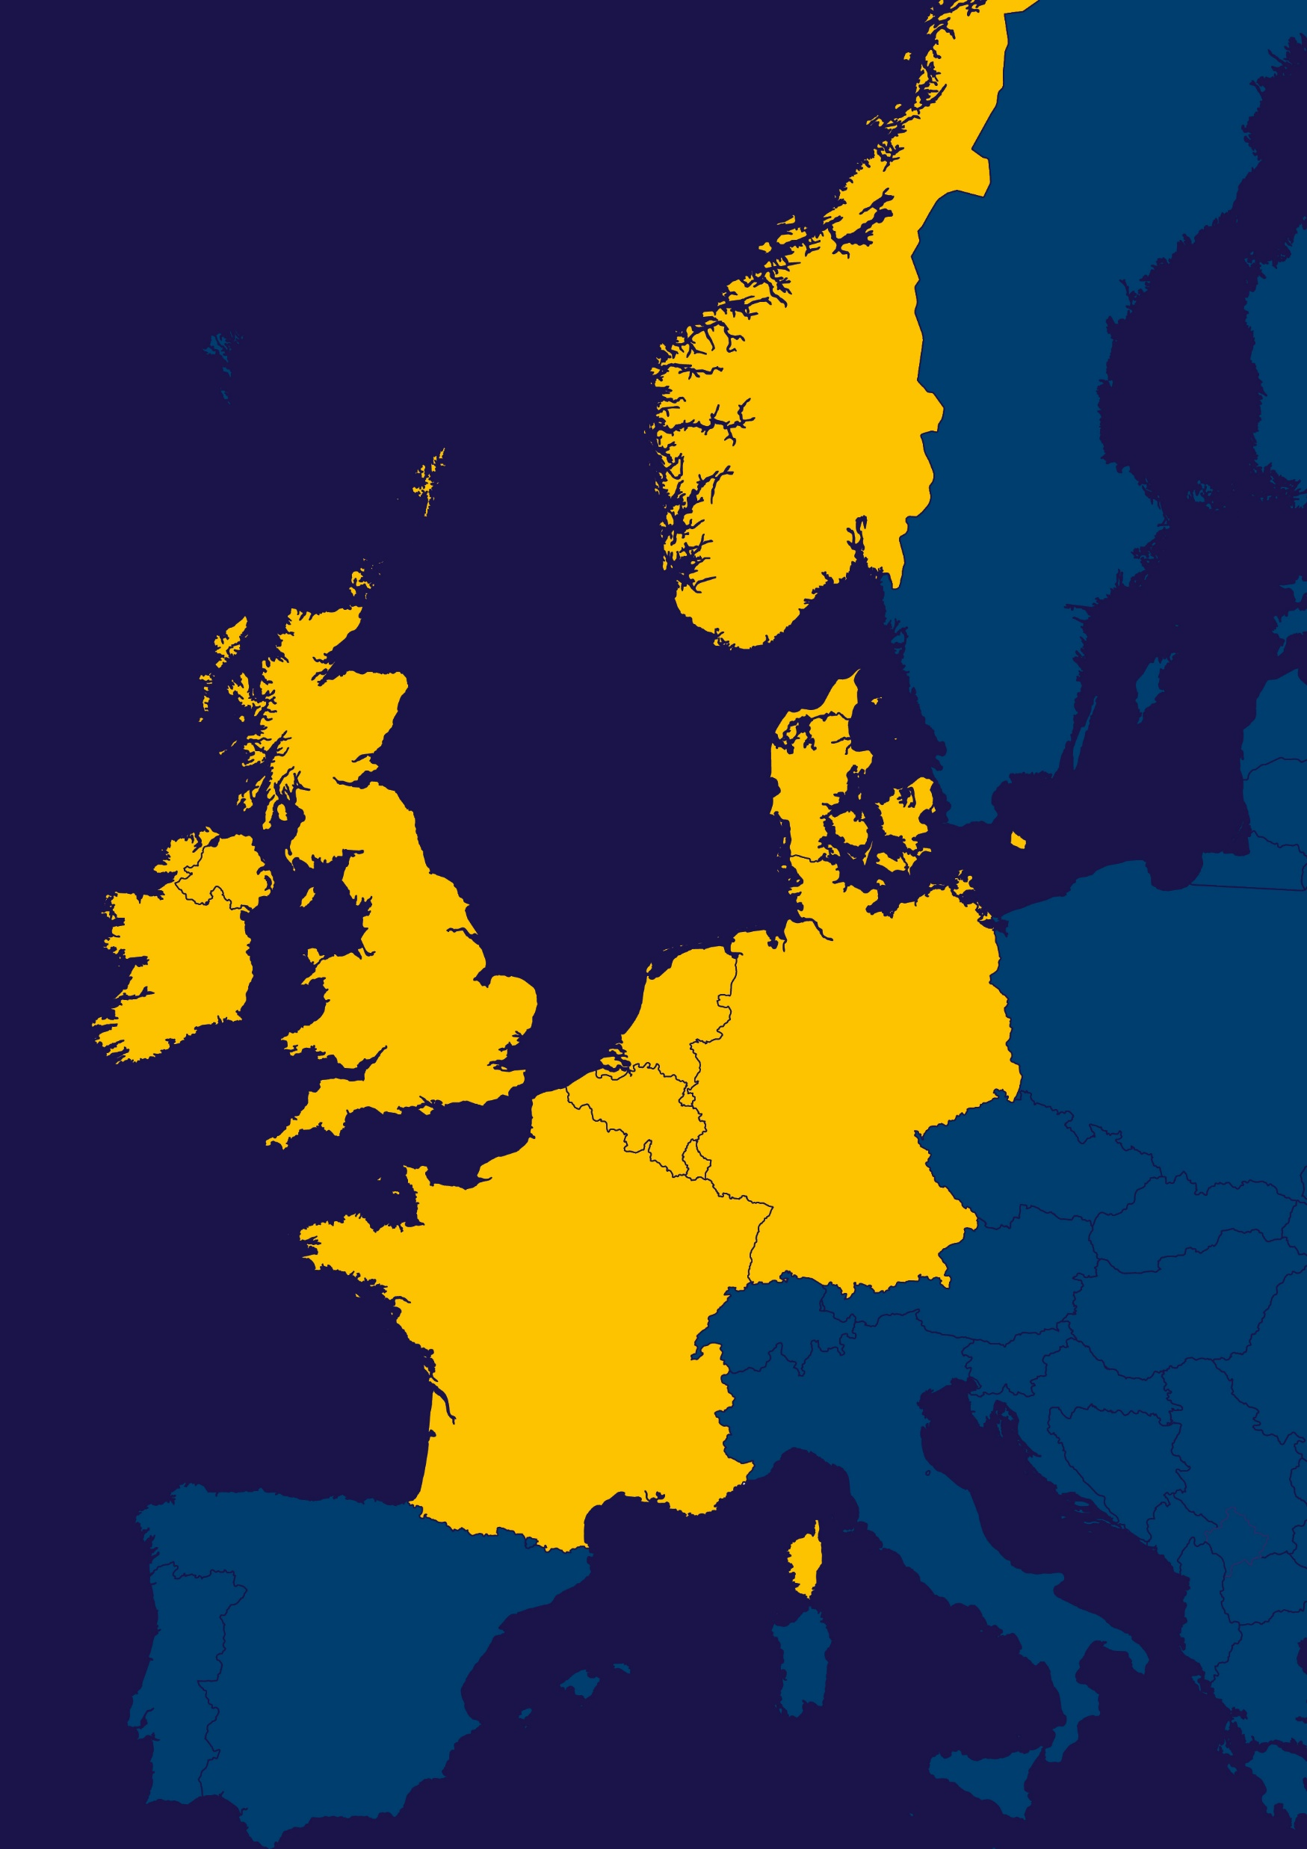
Antje Orths
Convenor RG North Seas

Slide 33
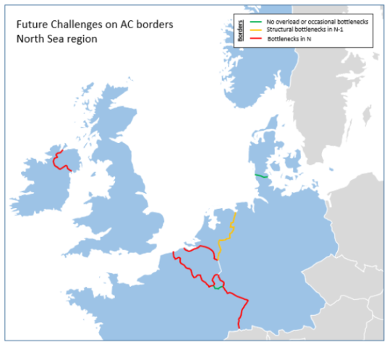
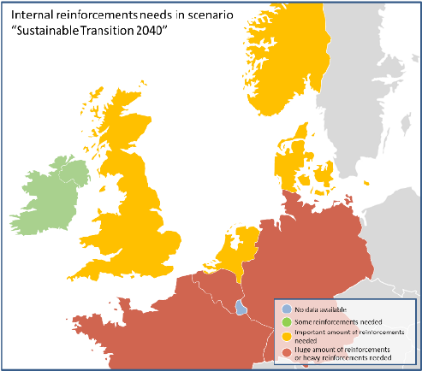
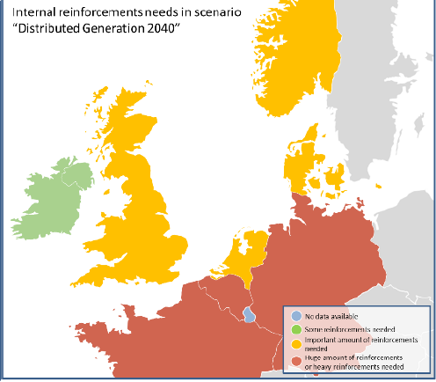
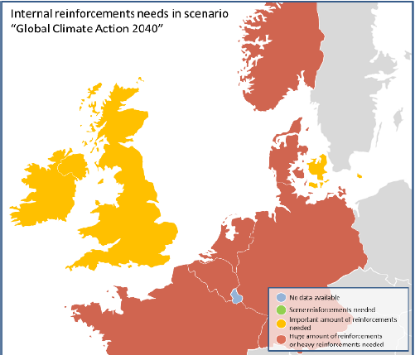
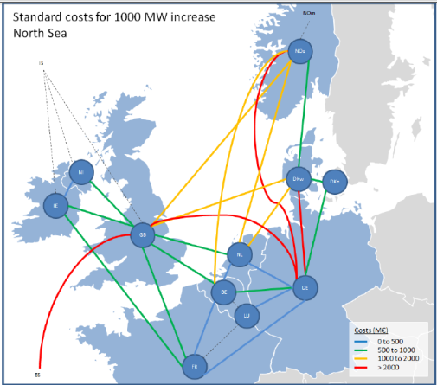
The Region’s key messages for its evolution are..
Continued structural changes of the generation fleet, including:
  A shift from thermal- to RES- generation
  A reduction of nuclear generation and
  A shift from coal to gas
The development of offshore RES and related off- and onshore infrastructure contributes to the above changes
Increased weather impact on hourly adequacy, requiring stable mechanisms ensuring generation sharing
Need for flexibility in the system
to support adequacy and to avoid RES curtailment
Closer connection across the region’s main boundaries
to support adequacy and further integrated markets
Challenged
AC borders
Internal
reinforcement
needs
Standard costs
per 1 GW
RGNS RegIP – details online: http://tyndp.entsoe.eu/

Slide 34
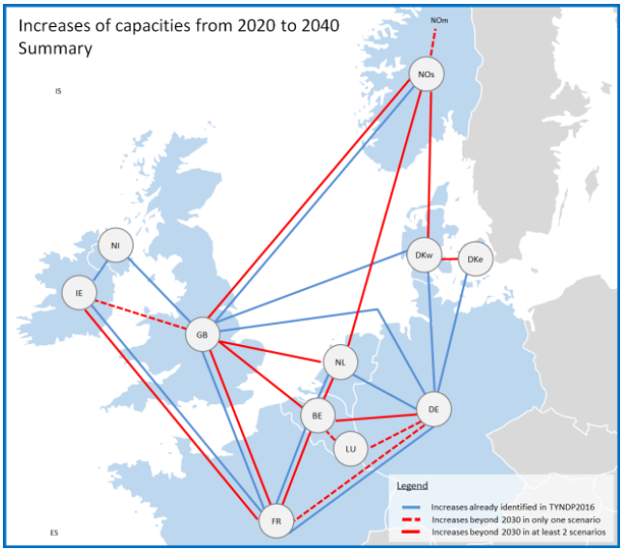
Identified Needs
Further integration NO-GB due to:
  Price differences
  Need for flexibility to optimize the RES generation (hydro / wind)
Further integraton NO-Continent due to:
  Price differences
  Need for flexibility to optimize the RES generation (hydro / wind)
  Provision of support to continental SoS in low-wind periods
Further integration GB-Continent, due to
  Price differences
  Better optimization of RES generation
  Challenged SoS in high demand/ low variable RES (wind and solar) periods
Further integration DE-FR/BE; BE-NL (east-west), due to
  optimization of the production system
  Challenged SoS in high demand/ low variable RES (wind and solar) periods
Further integration IE/GB - FR, due to
  Price differences
  Better optimization of RES generation
  Challenged SoS in high demand/ low variable RES (wind and solar) periods
RGNS RegIP

Slide 35
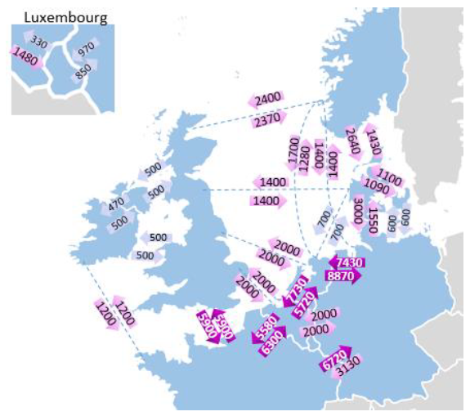
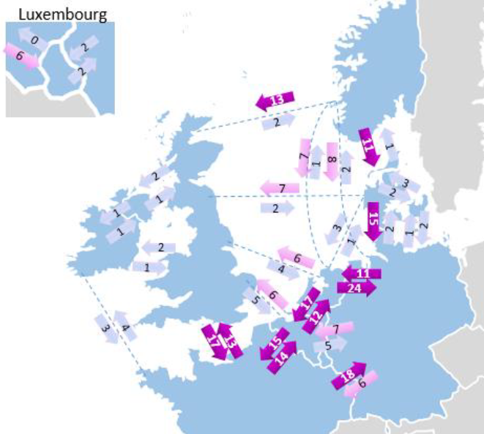
Expected Power Flows (e.g. 2040, GCA)
RGNS RegIP
5th percentile [MW]; with scenario capacities
Expected annual energy transfer [TWh], with scenario capacities

Slide 36
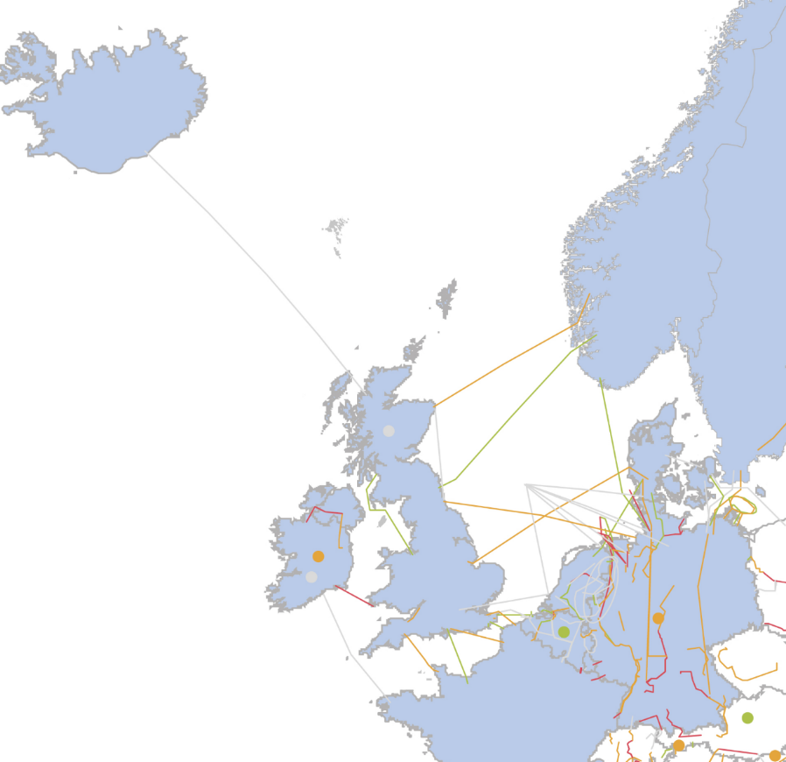
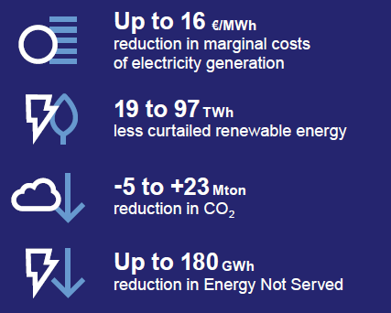
Promoted Projects…
.. which will be analysed
with CBA methodology
in TYNDP18
Benefits…
…referring to IoSN 2040 capacities
compared to the 2020 grid
RGNS RegIP -> online map: http://tyndp.entsoe.eu/map/

Slide 37
Thank you for attention

Slide 38

Antti Harjula
RG Baltic Sea

Slide 39

The Region’s key messages...
Regional Group Baltic Sea:
Norway, Sweden, Denmark, Finland, Estonia, Latvia, Lithuania,
Poland and Germany.
Continued structural changes of the generation fleet, including:
  A shift from thermal- to RES- generation
  A reduction of nuclear generation (DE, SE)
  A shift from coal to less CO2 intensive generation
Increased operational challenges for the system
Need for exchange of flexibility between different synchronous areas
Closer connection across and out of the region to support adequacy and further integrated markets
RGBS RegIP – details online: http://tyndp.entsoe.eu/

Slide 40

Key drivers for grid development Region Baltic Sea
Further integration between Nordic countries and the Continent/UK
RES-integration
→ North south flows
New consumption
Baltic integration/synchronization
Nuclear and thermal decommissioning
2&5

Slide 41
Identified Needs
Germany-Poland
  increase market-integration
  facilitate thermal decommissioning
Sweden-Finland
  increase Nordic market-integration
Norway-Denmark
  lower price-differences
  increase Danish security of supply
Sweden/Denmark-Germany
  lower price-differences
  optimize RES-generation(hydro/wind)
Poland-the Baltics and internal in the Baltics
  increase market-integration
  increase security of supply for the Baltics
Benefits…
…referring to IoSN 2040 capacities compared to the 2020 grid
RGBS RegIP

Slide 42

Promoted Projects…
.. which will be analysed
with CBA methodology
in TYNDP18
RGBS RegIP -> online map:
http://tyndp.entsoe.eu/map/

Slide 43
Thank you for attention

Slide 44

CSE
Nebojsa Vucinic
Convenor RG Continental South East

Slide 45

The Region’s key messages...
Regional Group Continental South East:
AL,BA,BG,HR,CY,GR,HU,IT, ME, MK, RS, RO and SI.
Today, the grid in the CSE region (especially in the Balkan area) is rather sparse compared to the rest of the continent. This leads to insufficient transfer capacities; the increase of existing transfer capacities (both cross-border and internal) is a prerequisite for market integration.
The main challenges and drivers of transmission grid development in the region are:
Increase of Transfer Capacities and Market Integration facilitation.
Massive RES integration in order to achieve EU and National targets.
Flexibility needs, especially for the countries with the highest RES penetration in the region.
Extensions of ENTSO-E system to the East and South.
These challenges are reflected in the planned projects and are confirmed by the system needs identified for 2040.

Slide 46

Main challenges of the Region
Enlarging the synchronously connected Europe
  Ukrainian and Moldavian synchronous interconnection to Continental Europe Power System
  Identified needs for increasing cross-border capacity with Turkey
Increasing cross-border capacity in non-EU countries

Slide 47

Identified Needs
Strengthen the E-W and N-S axis by increasing transfer capacities in the respective borders in order to:
Cope with the assumed high RES penetration in TR, RO and GR
Cope with high transit power flows in the RS transmission network
Assist market integration in the Region

Slide 48


Promoted Projects…
... which will be analyzed
with CBA methodology in TYNDP18
Benefits

Slide 49
Thank you for attention

Slide 50

ccs
Ettore Elia
Continental Central South

Slide 51
The Region’s key messages for its evolution are..
Large developments of variable wind and photovoltaic power, especially at the corners of the CCS region, the nuclear phase-out, mainly gas-based thermal generation, and the pump storage potentials in the Alps are some of the outstanding characteristics of the region that will challenge the whole future electricity system and especially the transmission system.
Main drivers for power system evolution:
Massive RES integration
Nuclear phase-out and existing thermal capacity dismissing or mothballing
Efficient integration of storage plants in order to facilitate the full exploitation of RES
Gas dependence of thermal generation
Wide area power flows
System stability and security of supply

Slide 52


System Challenges to be faced…
Results from MST and NST on all three 2040 scenarios (Sustainable Transition, Global Climate Action and Distributed Generation) have revealed challenges that the power system will have to face if the grid would not evolve beyond 2020, like:
bottlenecks between market areas and inside these areas
security of supply issues
poor integration of renewables (high amounts of curtailed energy)
high price differences between market areas

Slide 53

Identified Needs
The outcomes of the analyses highlighted the importance of the confirmed TYNDP 2016 projects to meet market integration needs, increase the sustainably of the transmission system by integrating more RES generation and improving the security of supply.
The following additional four new transmission projects were proposed for inclusion in the TYNDP 2018, on top of TYNDP 2016 confirmed projects:
  AT-SI: 500 MW (improvement of the existing cross-border network).
  CH-FR: 1500 MW (the three following projects: PST Foretaille, Lake Geneva South and upstream reinforcements in France).
  ITcs-ITcn: 1000 MW (project HVDC internal Adriatic link).
  ITsar-ITsic-ITcs: 1000 MW (project tri-terminal HVDC link connecting main Italian islands).
Notes:
The map shows the needs for cross-border capacity increases beyond the expected 2020 grid in 2040.
Based on additional assessment carried out to understand the probability of occurrence of the identified needs and their concrete feasibility,

Slide 54


Promoted Projects…
.. which will be assessed
with CBA methodology in TYNDP 2018
Benefits
*
* Referred to IoSN 2040 capacities compared to the 2020 grid

Slide 55
Thank you for attention

Slide 56

CCE
Lubos Samsely
Convenor RG Continental Central East

Slide 57



Main challenges of the Region
Generation mix change
  Different nuclear and fossil policies of the CCE members
  Massive RES integration
Generation location change
  Dispersed generation
  Commissioning and decommissioning of the „central“ power plants

Slide 58

Main challenges of the Region
Enlarging the synchronously connected Europe
  Ukrainian and Moldavian synchronous interconnection to Continental Europe Power System
  Baltics power systems synchronous connection to Continental Europe Power System

Slide 59









Future system needs
System needs identified during the IoSN TYNDP2018 process
  RES integration improvement;
  SoS improvement;
  CO2 emissions decrease;
  Strengthening cross-border and internal grid;

Slide 60

Future capacity needs
In the TYNDP2016 process following cross-border capacity increases have already been identified by introduction of the new transmission projects:
  Germany - Poland
  Germany - Czech
  Germany - Austria
  Slovenia - Croatia
Further capacity increases on the cross-border profiles have been identified in TYNDP2018 IoSN process:
  In order to improve market integration
    Germany - Poland
    Austria - Slovenia
    Slovenia - Croatia
    Hungary - Romania
  In order to improve security of supply
  Czech - Slovakia
Identified capacity needs will be partly or fully „covered“ by the future transmission projects, which will be as well assessed in the TYNDP2018.
These future projects has to be considered as the future grid extension possibilities and are subject to change based on the assumptions in future scenarios

Slide 61

Promoted Projects
... which will be analyzed
with CBA methodology in TYNDP18
Benefits

Slide 62
Thank you for attention

Slide 63


