Slide 1
ENTSO-E Transparency Platform Vision Project
Market European Stakeholders Committee
11 December, 2017

Slide 2
Project main objectives
Data Quality Improvements
(Manual of Procedures revision)
Data completeness
(Integrated reporting system)
GUI Enhancement

Slide 3
Manual of Procedures – revision n. 1
Data Quality
- Review carried out with ACER and Stakeholders in 2016 & 2017
- Over 12 data items reviewed resulting in over 100 new requirements for the TP
- Related developments are now being implemented on the ENTSO-E TP
- First release expected in mid December
- Second release Q1 2018
Objective
Improve data descriptions to:
- avoid misinterpretation
- improve data quality
- Related development of data provider systems is also ongoing
- Most data providers are expected to be ready by mid 2018

Slide 4
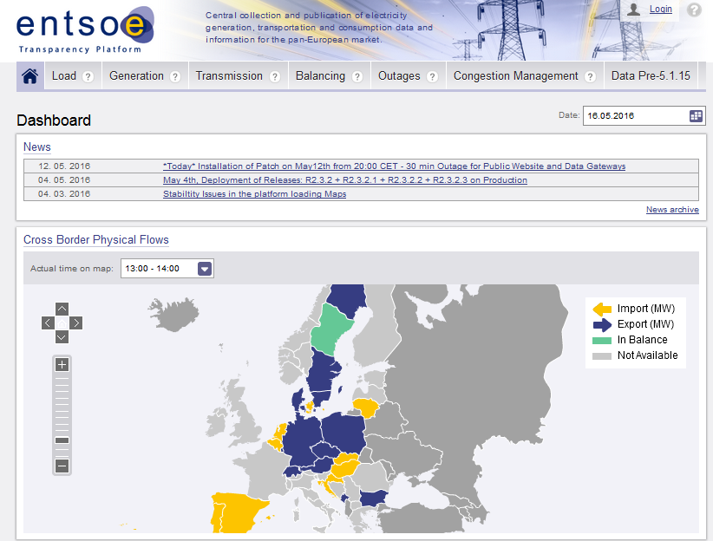
Data completeness – integrated reporting system
Data Completeness
Reports automatically prepared and sent by the TP to data providers to identify data completeness issues
Based on the reports the data providers can act quickly to fill potential gaps and shortcomings
Further reports will be developed also for other purposes …

Slide 5
List of reports existing and to be developed
Existing (but elaborated manually)
For admin view
Technical Monitoring
Server load
system resources
available disk space
etc.
Data Flow Monitoring
What happened to the files accepted vs rejected
Data Item Monitoring
What data are missing
How many files were submitted
Gate Closure Monitoring
Which data are delivered on time, (based on TP reg.)
For data providers view
For ACER view
Planned (Automated elaboration through Tableau)
2018 January
2018 January
Missing Data Monitoring
Which data are missing/ not submitted
Technical Monitoring
Server load
system resources
available disk space
etc.
Data Processing Monitoring
Arrival date & time
End of validation date & time
Publication date & time
ACER Flow Monitoring
Whether submission to ARIS was successful
Completeness Monitoring
Per geographical area
Per data item
Per Data provider
Platform Incident Monitoring
Weekly, Monthly, custom
Remedial action by vendor
Plausibility Check Monitoring
Data have unreasonable values
Data exceeding asset’s limitations
System Overview Monitoring
System overview

Slide 6
Graphical User Interface
GUI enhancements
TP GUI needs to be upgraded; pointed out by user group members but also in general by stakeholder via different surveys
Key elements for improvement proposed by users are taken into account
Designs proposals received by two different companies
Requirements finalization in early 2018 that is to be followed by development in 2018

Slide 7
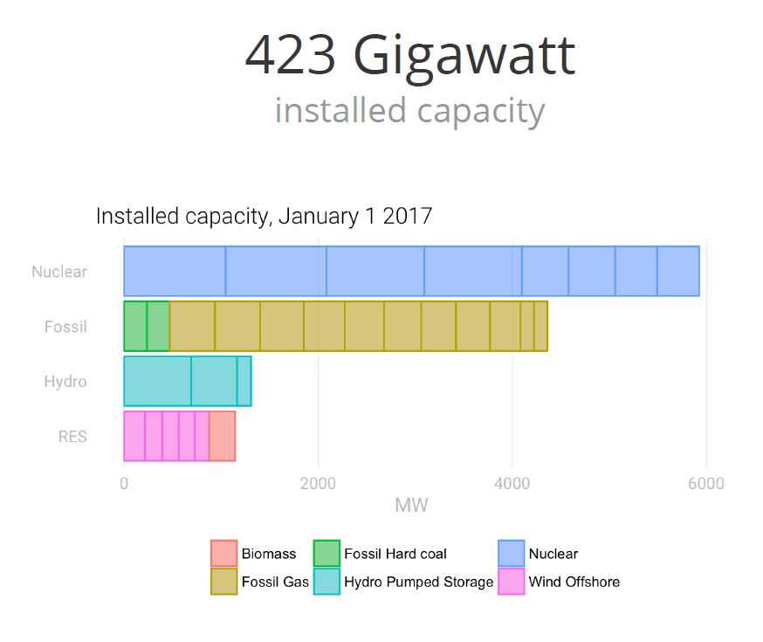
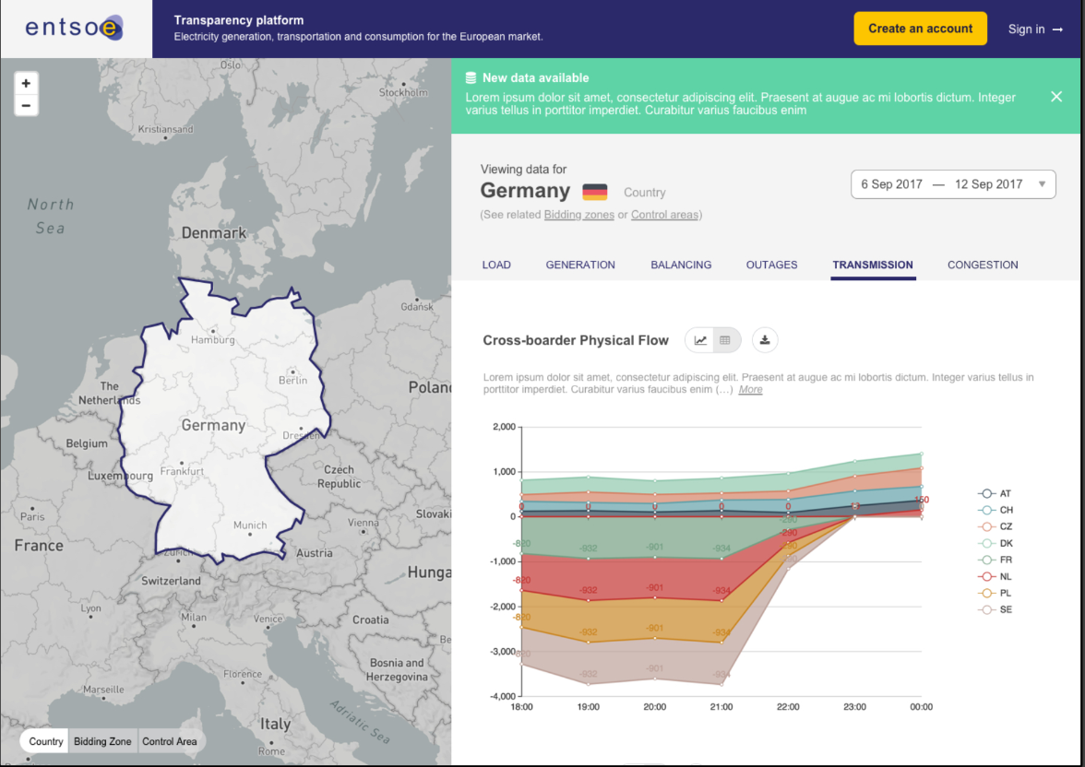
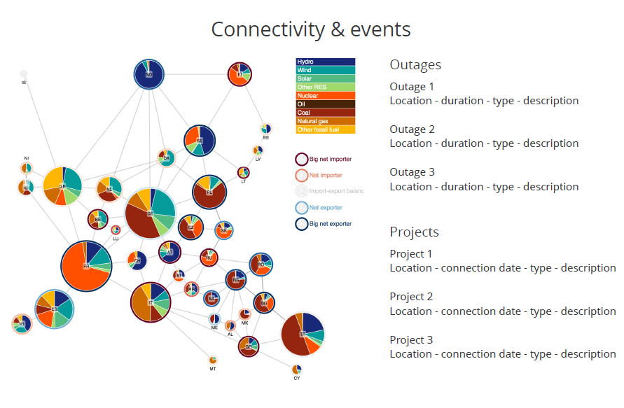
Proposals for GUI improvements

Slide 8
Draft project plan

