Slide 1
Update on Technical Groups On-going and planned activities
Ioannis Theologitis, ENTSO-E
12th Grid Connection European Stakeholder Committee Meeting
13 December 2018, Brussels

Slide 2
Technical Groups
High Penetration
Compliance Monitoring

Slide 3
Technical Group on High Penetration (TG HP)
Volunteers from 6 stakeholder groups:
TSOs: 2 Representatives
Wind Manufacturing Industry: 4 Representatives
HVDC Manufacturing Industry: 2 Representatives
PV Manufacturing Industry: 1 Representative
Power System Analysis tool providers/Consultants: 2 Representatives
Academia: 2 Representatives
Stage 2 (2017 – 2019): High Penetration (HP) Longer term analysis and input into issues of extreme high penetration
Is currently working on a joint report on grid forming capabilities
Contribution for setting up requirements on grid forming capabilities in future grid/network codes
Inputs:
Links to research projects e.g. Migrate and Osmose
Projects with focus grid forming were already collected
Liaison with EG hosted by National Grid
Last meeting: 21-22 November with >10 participants

Slide 4
Structure of the report
1 Abbreviations.
2 Terminology and Definitions.
3 Situation of European Power Systems as of today.
4 Power System Development up to 2030.
5 Power System Needs.
5.1 Classification of scenarios.
5.2 Classes of Power Electronic Interfaced Power Systems.
5.2.1 Class 1 PPMs or HCSs.
5.2.2 Class 2 PPM / HCS.
5.2.3 Class 3 PPM / HCS.
5.3 Requirements for Grid Forming Power Electronic Interfaced Power Systems.
5.3.1 Create system voltage.
5.3.2 Contribute to fault level
5.3.3 Fault current contribution.
5.3.4 Sink for unbalances.
5.3.5 Sink for harmonics.
5.3.6 Contribution to inertia.
5.3.7 First cycle survival / emergency support, survival of LFDD.
5.3.8 Prevent adverse control interaction.
5.4 Must-Run Units.
5.5 Spatial Distribution of Grid Forming Units or Must-Run Units.
6 Proposed Tests and Benchmarking.
7 Literature References.
8 Annex.
PPM: Power Park Module
HCS: HVDC Converter Stations
LFDD: Low Frequency Demand Disconnection
Final report >60 pages

Slide 5
Technical Group on compliance monitoring (TG CM)
Members of the Technical Group collaborate with the TC8X WG3 team for the development of 50549-10
The IGD on Compliance Monitoring has been considered as one of the inputs for the development of -10
Please refer to CENELEC’s presentation for the progress of work
It is intended to have a meeting as TG in Q1/Q2 2019 including the rest of the members / stakeholders that are not part of the WG3 and discuss on some key aspects of a developed draft

Slide 6
Monitoring of non-exhaustive requirements

Slide 7
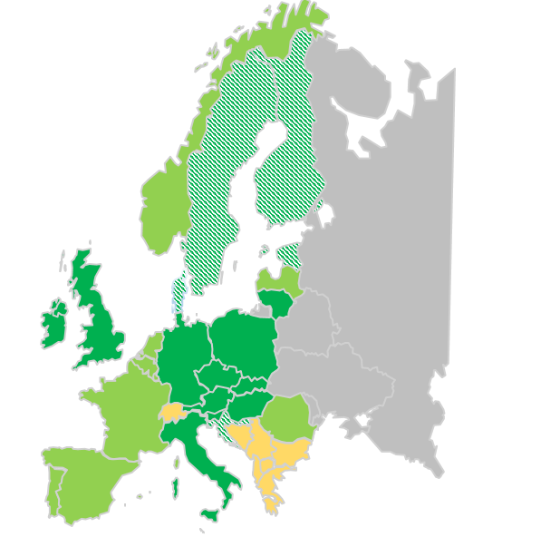
CNC Implementation Monitoring
 | No response
 | Not approved yet
 | Approved in due time
 | Not provided link to the file
RfG NC
The RfG list is advanced with all the non-exhaustive parameters under approval or approved
Efforts for the improvement of DCC and moreover the HVDC list are ongoing. Most of the submitted proposals have been collected and final approval is pending
More details on the proposals of the TSOs here:
https://docs.entsoe.eu/cnc-al/docs/CNC_Non_exhaustive_requirements.xlsx

Slide 8
Overview of planning

Slide 9
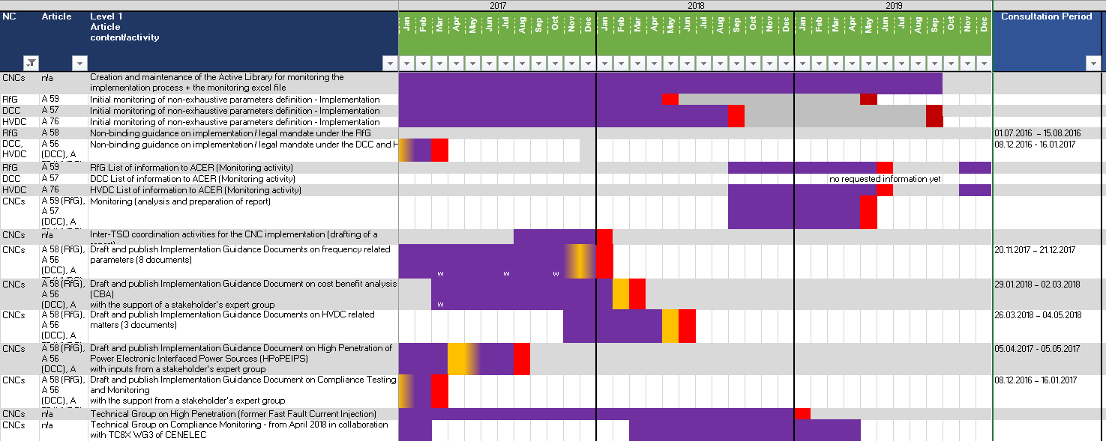
Overview planning for next months

Slide 10
GC ESC EGs meetings
18 January 2019, webinar, 14:00-16:00
7 February 2019, webinar, 14:00-16:00
15 March 2019, webinar, 14:00-16:00
Date for physical meeting is pending
Expert Group on Pump Storage Hydro
15 October 2018, 11:00-16:00, kick off meeting, ENTSO-E
13 November 2018, 14:00-16:00, webinar
10 December 2018, 14:00-16:00, webinar
Expert Group on Identification of storage devices
15 October 2018, 11:00-16:00, kick off meeting, ENTSO-E
23 November 2018, 13:00-15:00, webinar
20 December 2018, 11:00-13:00, webinar
Expert Group on Mixed Customer Sites
19 October 2018, 11:00-16:00, kick off meeting, ENTSO-E
19 November 2018, 14:00-16:00, webinar
17 December 2018, 14:00-16:00, webinar
Dates for 2019 meetings to be decided at the last EG meetings of 2018
The date for a joint EGs meeting is explored possibly for late February

