Slide 1
Temporary usage of equipment > 420 kV
Feedback from TC8(X)
Presented at ESC CNC meeting
13 December 2018
Wouter Vancoetsem
(convenor TC8X/WG03)

Slide 2
What has been done
Letter from ENTSO-E (SEP 4th)
Responses by TC Officers from IEC TC8, TC17 and TC99 : TC8X/MEETING18/9 (attached to this presentation)
Discussed at the CENELEC TC8X plenary meeting (NOV21st)

Slide 3
Main items in TC8(X) response
IEC 60038 and IEC 60071-1 are Horizontal standards in the IEC. As a consequence, they have been used for decades as reference by many TCs.
It is a pity that technical issues of this kind could not be solved at earlier stage in the drafting process of EU network codes through deeper cooperation with Standardization Bodies.

Slide 4
Main items in TC8(X) response (cont)
in case specific equipment are to be designed for European Networks there will be an economic issue for Network Users and Operators and an industrial issue for Equipment Manufacturers but, the discussion, resulting from conflicting EU regulation, should first be considered at CENELEC Level.
we can offer that CLC TC8X is used as a discussion forum

Slide 5
TC8X Plenary meeting (Nov 21st)
Mitja Psaker (ENTSO-E) presents an ENTSO-E report related to their letter
No participant from TC99 and TC17
The focus of the presentation is limited to the issue > 420 kV.
TC8X (and IEC TC8) are concerned with IEC EN 60038 (standard voltages)
IEC EN 60038 reflects Market Situation

Slide 6
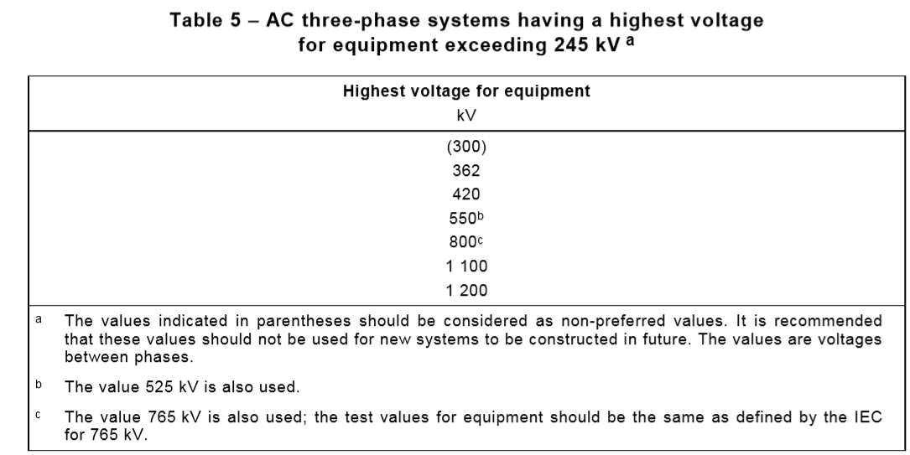
TC8X Plenary meeting (Nov 21st)
Extract IEC EN 60038 – Standard voltages

Slide 7
NEXT Step
Industry stakeholders have asked IEC/SMB/Advisory Committee on Transmission and Distribution (ACTAD) to discuss the topic during its next meeting (DEC2018).
TC8X will wait for a recommendation from ACTAD on this subject, if any.
To be prepared for a coordination meeting with all interested TCs and stakeholders in 2019

