Slide 1
Grid Connection ESC Expert Groups site
Ioannis Theologitis, ENTSO-E
12th Grid Connection European Stakeholder Committee Meeting
13 December 2018, Brussels

Slide 2
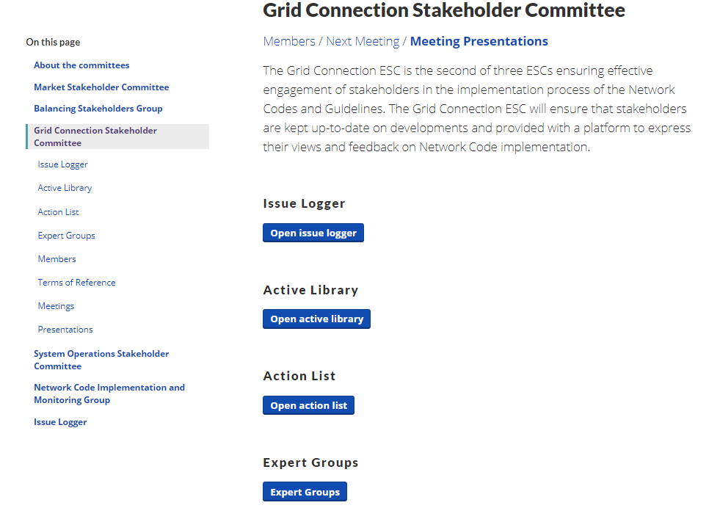
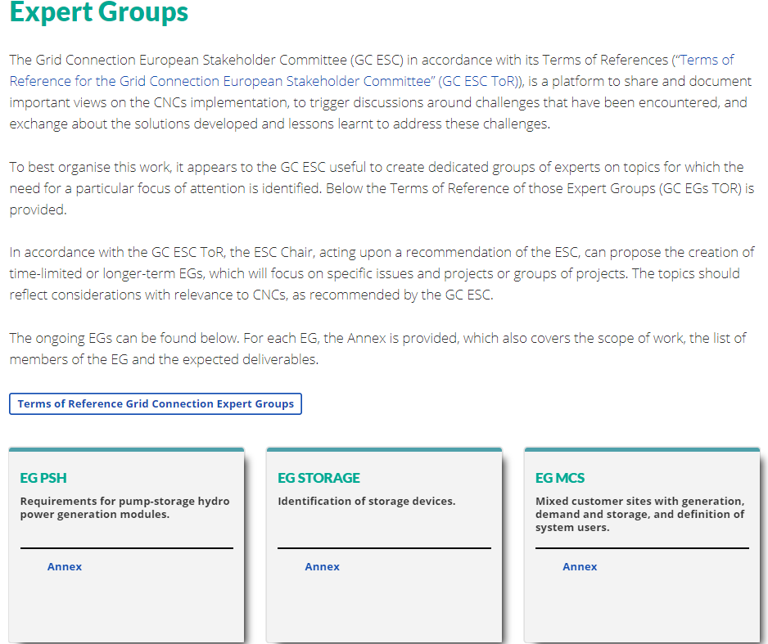
Dedicated site for the Expert Groups
https://www.entsoe.eu/network_codes/esc/#gesc
https://www.entsoe.eu/network_codes/cnc/expert-groups/
Completed EGs will be archived and remain visible at the website

