Slide 1
Balancing Implementation Projects
ENTSO-E
EBSG, 1 July 2019

Slide 2
Disclaimer
The information in this presentation is for informative purposes only. It does not in any case represent a firm, binding or definitive TSOs’ position on the content.

Slide 3
Agenda
Update from the implementation projects:
IGCC
PICASSO
MARI
TERRE (separate slides)

Slide 4
IGCC implementation
EBSG
1 July 2019

Slide 5
Agenda
IGCC regulation and contract
INIF: status of the imbalance netting implementation framework
IGCC Cooperation Agreement
IGCC implementation roadmap
Publication of information
Contact points in IGCC

Slide 6
IGCC regulation and contract
1) INIF (imbalance netting implementation framework):
NRAs requested ACER a two-month extension (exp. 15 July) of their deadline for approving the INIF and are working on a second request for amendments (RfA) for INIF.
It is likely that the new RfA will request to specify further the article on the entities of IGCC, focusing on the legal entity performing each of the functions instead of the current approach, which explains that all IGCC member TSOs are needed to run the platform and share responsibility.
2) IGCC Cooperation Agreement:
IGCC Member TSOs are finalising the update of the contract of the project, which started in Q4 2018.
This update was done to align it to the submitted INIF.

Slide 7
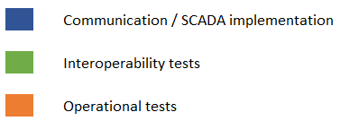
Implementation roadmap
EB GL Art. 22(5): deadline for implementation is one year after the approval of the INIF (est. Q2/Q3 2020).
Tentative not-binding roadmap |  | 2018 |  |  |  | 2019 |  |  |  | 2020
Country | TSO | Q1 | Q2 | Q3 | Q4 | Q1 | Q2 | Q3 | Q4 | Q1 | Q2
Slovenia | ELES
Croatia | HOPS
Denmark | Energinet
Poland | PSE
Spain | REE
Portugal | REN
Hungary | MAVIR
Italy | Terna
Slovakia | SEPS
Romania | Transelectrica
Bulgaria | ESO
Greece | ADMIE
Serbia | EMS | TBC

Slide 8
Implementation roadmap
Accessions
Denmark - DK1: changing communication protocols and becoming an LFC area before joining IGCC. Advanced planning of communication line.
Poland - PSE: communication lines planned and properties on SQM device agreed. Bilateral agreement for accounting of unintended deviations signed.
Spain - REE: one communication line being agreed between REE-RTE, which will enable to connect REE to TransnetBW.
Portugal - REN: one communication line getting ready in Q3 2019.
Hungary - MAVIR: advanced discussions on protocol and communication lines.
Italy - Terna: a third party communication line is currently in implementation, protocol discussions.
Slovakia - SEPS: advanced protocol discussions.
ESO, Transelectrica, ADMIE: internal planning discussions ongoing.
Serbia - EMS: pending decision by CE TSOs.
Technical discussions with NOS and CGES.

Slide 9
Implementation roadmap
Host TSO (TransnetBW):
TransnetBW has ordered protocol converters Tase/IEC for REE, REN, Terna and Energinet.
TransnetBW has ordered support from the protocol converter supplier to coordinate the communication of these TSOs with the converter.

Slide 10
Publication requirements
INIF 3(10) The netted volumes will be published as soon as possible and not later than 30 min after the relevant market time unit.
INIF 4(2)(e) The limitation of a given imbalance netting balancing border is allowed when duly justified by the relevant TSOs concerned by the imbalance netting balancing border. The concerned NRAs shall be notified of this limitation. The technical justification shall be published by the concerned TSOs.
IGCC is assessing several options for the publication of volumes and limits, including the Transparency Platform, each TSO websites, a dedicated IGCC website or 50Hertz site.
Based on the first analysis, the current long-term intention is to have the publications in the Transparency Platform.
Netted volumes are currently published in 50Hertz’s website (here).
The ENTSO-E website on IGCC is regularly updated with other information, e.g. the tentative accession roadmap and the quarterly social reports.

Slide 11
Publications of limits
Additional limitations due to security reasons
The request for limitation shall be published in a 30 minutes window after the relevant balancing market time unit in which it was requested (i.e. after the relevant 15 min when it was requested).
Permanent limitations to borders composed only by HVDC systems with technology not enabling IN
The limitation of a given LFC area border is allowed when duly justified by the relevant TSOs concerned by such border.
The relevant NRAs shall be notified.

Slide 12
Contact points for IGCC
Iason Avramiotis
Chairman IGCC Steering Committee
Dimitrios Nousios
Convener IGCC Expert Group
Ricardo Renedo Williams
IGCC facilitating party. ENTSO-E.

Slide 13
PICASSO implementation

Slide 14
Agenda
PICASSO implementation roadmap
PICASSO implementation guide
Coordinated work
Contact points in PICASSO

Slide 15
Implementation roadmap
EB GL Art. 21(6): deadline for implementation is thirty months after the approval of the aFRRIF (est. August 2022).
PICASSO TSOs are preparing national roadmaps on the implementation steps needed to be able to join the platform. These include different levels of changes:
Markets: including marginal pricing, free bidding, control-cycle volume determination, adaption of gate opening and gate closure times, MOL activation of balancing energy and incentives to react faster.
Legal: including market-related legal changes, approval of accessions, signature of contracts and notifications.
Technical: market-related technical changes, updates of interfaces with VSPs, installation of main communication line connections.
With these national roadmaps, PICASSO will create the accession roadmap for each TSO to become operational in PICASSO, similar to the one for IGCC.

Slide 16
Implementation guide
PICASSO has developed an implementation guide of the project. This explains, for a technical point of view, the information exchanges needed to run the platform.
This includes, among others:
Process data exchanges via different communication protocols for real-time communications.
Rules for non-real time communication exchanges.
This implementation guide has been reviewed by ENTSO-E.

Slide 17
Coordinated work
PICASSO, in coordination with ENTSO-E (MC, WG AS, PT Coordination) is doing additional work on other implementation aspects, such us:
Common invoicing of the balancing platforms;
Capacity management module;
Governance of IGCC and PICASSO once both go live

Slide 18
Contact points for PICASSO
Pavel Zolotarev, Amine Abada
Chairmen PICASSO Steering Committee
Julien Gaudin, Simon Remppis
Conveners PICASSO Expert Group
Ricardo Renedo Williams
ENTSO-E support to PICASSO

Slide 19
MARI implementation

Slide 20
EBSG meeting
01. 07. 2019

Slide 21
Focus for the MARI Project
Organisation between 43 TSO’s
Allocation of tasks
Liability and cost sharing
Preparing IT procurement and system infrastructure

Slide 22
MARI - Organisation structure
PMT = Project Managment Team
Martin Høgh Møller (Energinet.dk) - Chairman
Ulf Kasper (Amprion)
Amine Abada (RTE)
Iason Avramiotis Falireas (Swissgrid)
MARI SC
Cross-Project Coordination
PICASSO SC
SC Chairman
PMT
WS Roadmap /Budget
PMO
IT PMO
WG Technical
Aurelien (RTE)
WG IT
Jan Hermens (Amprion)
WG Legal
Astrid Brunt (SN)
WS
R&M
WS
Design
WS
SET
WS
ABS
TF Business Analyst
WS … (TBD)
WS … (TBD)
WS
IFA
WS
LDD
WS
PAT
Fredrik (R)
Václav (M)
Didier
Matthias
Iason
External - Schlyter
Provided by the TSOs
Astrid
WG | Working Group | ABS | Algorithm and Bid Structure
WS | Work Stream | PMO | Project Management Office/Officer
IFA | Implementation Framework Acceptance | R&M | Reporting and Monitoring
LDD | Legal Documents Drafting | SET | Pricing & SETtlement
PAT | Procurement and Allocation of Tasks | TF | Task Force

Slide 23
Allocation of task specific for the MARI platform
A
B
C
Task B and C should be bundled in one offer
TSO’s are in the progress of allocating the above task to specific TSO’s
MARI and PICASSO Projects are following the same procedures

Slide 24
Potential trigger for planning adjustment
Platform development
02/19
03/19
04/19
05/19
06/19
07/19
08/19
09/19
10/19
11/19
12/19
01/20
Reference Document
Reference document
Review
GAP analysis
GAP analysis
Review
Complement to GAP
Requirement Catalogue (RC)
Pre Analysis
RC - closed points (V1)
Requirement Catalogue – final (V2)
Review
Review
Implementation guide
Implementation guide 2.9.19 - 31.12.20
Tender preparation
Determining procurement method
Tender planning = submission of tenderers, opening, selection, evaluation and award
Official specification documentation
Tender for provider
Tender notice
RfP launch
Tender process
Legal preparation
Determining model of contract
Preparation of (template) supplier contract
Contract negotiation
Cooperation contract (after MC decision)
Decision on jurisdiction of procurement (SC /who)
Mandating tendering TSO (power of attorney or agreement)
IT
Support of BA and IT requirement Catalogue drafting
Input for decision on hosting
Support of LWG
MC meeting
NRA’s Deadline

Slide 25
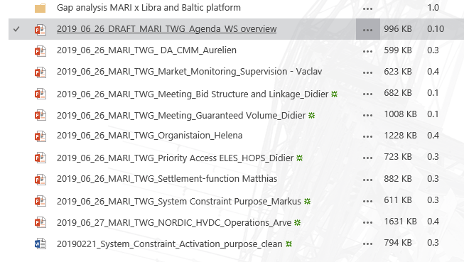
Technical work presently being performed in MARI
Session file from the TWG meeting 26/6-2019

