Slide 1
Shadow opinion on the Activation Purposes proposal

Slide 2
Topics addressed in the shadow opinion
Definitions and interpretations
Activation purposes and classification criteria
Implementation timeline and roadmap

Slide 3
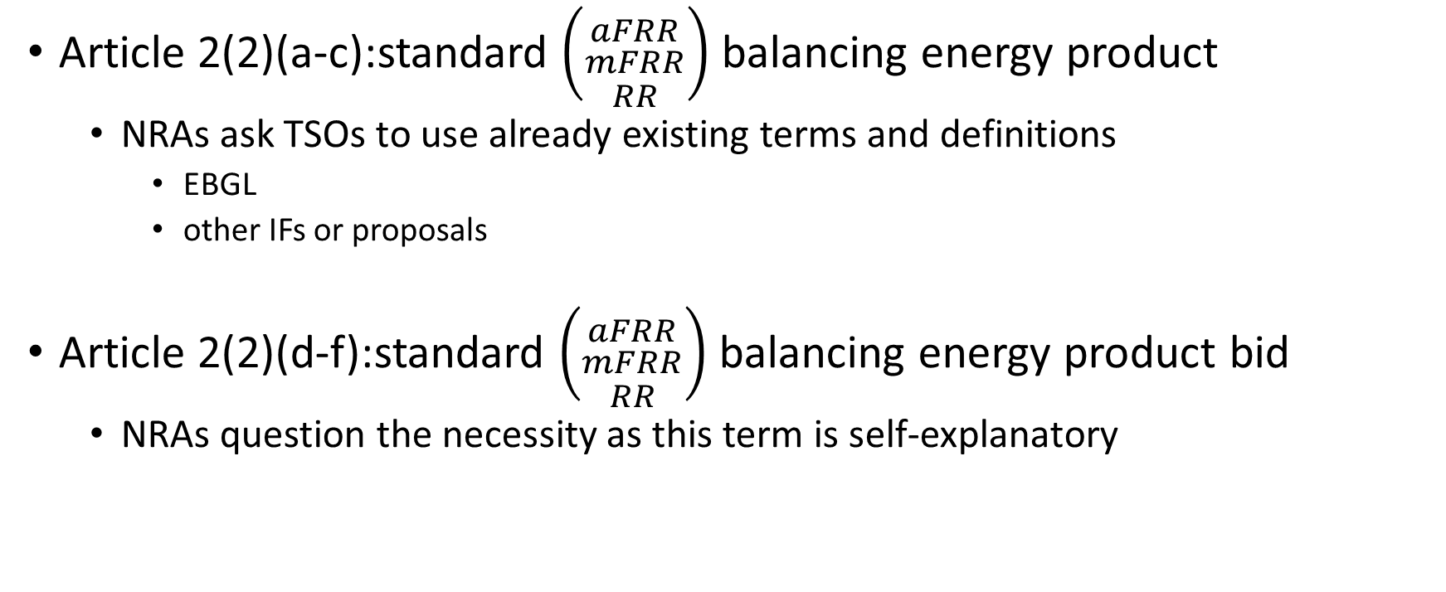
Definitions and interpretations
Article 2(2)(a-c):standard $\left({aFRR \atop \begin{aligned}mFRR \\ RR\end{aligned}}\right)$balancing energy product
NRAs ask TSOs to use already existing terms and definitions
EBGL
other IFs or proposals
Article 2(2)(d-f):standard $\left({aFRR \atop \begin{aligned}mFRR \\ RR\end{aligned}}\right)$balancing energy product bid
NRAs question the necessity as this term is self-explanatory

Slide 4
Activation purposes and classification criteria (1/3)
Article 29(3) EBGL : […] This methodology shall:
(a) describe all possible purposes for the activation of balancing energy bids;
(b) define classification criteria for each possible activation purpose.
Proposal: The TSO activating the bid from the common merit order list shall use the following activation purposes:
balancing;
system constraints
NRAs consider the proposed classification as not sufficient
Vague
Not conclusive

Slide 5
Activation purposes and classification criteria (2/3)
NRAs consider the proposed classification as vague
Almost all the activations from platforms could refer to articles 143 and 144 of SOGL.
Clear list is needed for category “system constraint” instead of “other than balancing”
Unclear whether a single activation can be classified with more than one purpose
NRAs consider the proposed classification as not conclusive
NRAs ask a more extensive list of possible purposes
E.g. congestion management: “redispatch”, “countertrading”

Slide 6
Activation purposes and classification criteria (3/3)
Additional remarks
Since no locational information exists on the platform, NRAs envisage only interconnector controllability as “system constraint” when activating RR and mFRR bids. The reason for activating bids need to be clear, i.e. HVDC management, counter trading
NRAs ask why recital 6 of the pricing proposal is not explicitly reflected in the activation purposes proposal and if there is the intention in the future to use direct activations also for other purposes
whether and how they intend to monitor and assess the impact of activations “other than balancing” on the bids availability for balancing in next time frames
how the activation purpose is notified by the activating TSO to all TSOs according to Article 29(4) EBGL.

Slide 7
Implementation timeline and Roadmap
Article 5(5) EBGL: The proposal for terms and conditions or methodologies shall include a proposed timescale for their implementation and a description of their expected impact on the objectives of this Regulation
NRAs ask
to add a specific reference in the recitals
To remove references to IFs and to elaborate article 4(2) in the activation purposes proposal
add a timescale for implementation, independent of other methodologies

