Slide 1
Europex views on the process and on the most recent proposals consulted by the TSOs
Electricity Balancing Stakeholder Group
Brussels, 19 November 2018
Association of European Energy Exchanges

Slide 2
General comments on EB GL implementation
EB GL implementation requires the delivery of complex projects with a large number of processes and deliverables, and many stakeholders.
We welcome the engagement opportunities that the balancing platform projects have given stakeholders to date.
In particular we welcome:
the public consultations;
the events/workshops, which have been held at various locations in Europe.
However, we identify in the following slides a number of areas where we recommend improvements.

Slide 3
1. A holistic approach to EB GL implementation is needed
EB GL splits up many interacting and interrelated topics into separate work streams with separate deadlines. This is very unhelpful with regards to practical implementation of the requirements.
It would be helpful if the many proposals were not split into separate work streams but rather a holistic approach were adopted.
A holistic approach would ensure that teams, whose proposals will interact, work closely with each other at all times, so that one proposal does not require a late change to another proposal.
A good example of the holistic approach, and is a very welcome development, is the WS’ and other work that ENTSO-E has offered on balancing energy pricing based on considering RR, mFRR and aFRR pricing issues altogether.

Slide 4
2. Interaction of different timelines for implementation create unnecessary project risk
Late clarification of requirements is envisaged for major IT projects such as TERRE. This adds risk to projects and often the timelines are then very short.
For example, TERRE is required to be implemented by end 2019 (the exact date will depend on when NRAs approve the design). However, the balancing energy pricing proposal which may impact TERRE may not be approved until mid-2019, leaving at most six months to include this in the TERRE arrangements and local arrangements that interface with TERRE.
ENTSO-E can help by proposing timelines that allow for the changes in design where the EB GL allows them that flexibility.
EB GL allows the pricing proposal to be implemented up to a year after approval. We ask ENTSO-E to help by using the legal flexibility given to it in the EB GL for longer implementation times that will reduce the risk to major projects such as TERRE/local projects.

Slide 5
Local arrangements example: delegated operators
EU balancing
Platforms
(e.g. TERRE)
Activations
Activations
Prices etc.
Prices etc.
TSO
TSO
Local implementation projects also require:
Detailed design, incl. IT systems
Approval by local NRAs
Activations
Prices + data
BSPs
Standard product
settlement
BSPs
BRPs
BSPs
Delegated
operators
BRPs
Imbalance
settlement
Source: Europex; simplified illustration

Slide 6
3. Implementation timelines are challenging in themselves
The timelines for implementation in EB GL leave inadequate room for design and local approval
The EB GL was drafted in such a way that the timelines for implementation are very short, particularly if local arrangements need to be designed and then approved by local NRAs to fit with the EU-wide designs.
For example for TERRE local project work already started long before the TERRE design is approved by EU NRAs due to the short implementation timelines allowed.
ENTSO-E/NRAs/ACER can help by drafting appropriate timelines into the Network Codes and Guidelines, at least 18 months’ after NRAs’ approval of the various terms, conditions and methodologies.
We recognise and support the desire to move towards EU harmonisation, however, we strive for a robust and successful harmonisation.

Slide 7
4. Difficulties to translate the methodologies approved at EU level into national arrangements
The methodologies approved at EU level are high-level and have to be translated into national arrangements.
This adds to the implementation time required as the detail has to be specified either nationally or in later detailed consultation with ENTSO-E, or the EU IT, e.g. balancing platform, providers.
ENTSO-E can help implement more quickly and at less risk by specifying the requirements to a more detailed level than currently. However, we recognise that again the EB GL may have allowed too little time to complete the various proposals to this level.
ENTSO-E can help by allowing delegated operators who for example are responsible for local delivery of balancing settlement and/or imbalance settlement to be party to the detailed design and development work following NRAs’ approval of the high-level designs.
Delegated operators have a different core business to the TSOs. By including for example settlement from the start as a key interest (as would be achieved by including delegated operators) it would be ensured that complex settlement issues are not left until last.

Slide 8
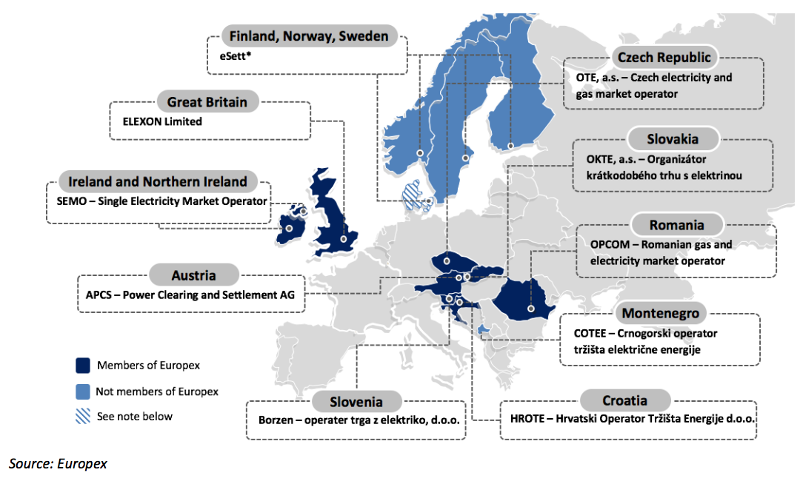
In future, delegated arrangements will need to be taken into account as EB GL projects develop
Delegated operators in Europe, 2018 – exist and operate in a dozen countries today
Note: *In Finland, Norway and Sweden, delegated services are performed by eSett, which is not a member of Europex. eSett services will extend to cover Denmark from 1 January 2019 which will be the 12th EU Member State to apply this regime.

Slide 9
Thank you.
© Europex 2018
www.europex.org

