Slide 1
FAT aFRR
Summary memo

Slide 2
Context
Currently, values from 2 to 15 min in Europe
Direct impact on the FRCE quality, with direct links to the frequency quality for small synchronous area
Direct impact on the volume offered from thermal units by BSPs, hence on competition and procurement costs
Potential candidates: 5 min and 7.5 min

Slide 3
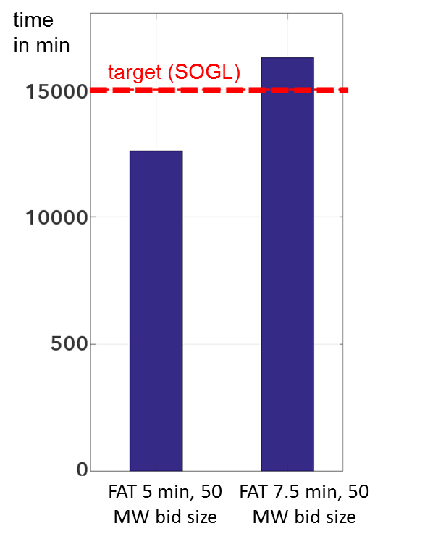
Technical assessment
Technical simulations run on a limited number of countries
Austria, Belgium, France, Germany and the Netherlands ➔ proxy for the other countries
Different assumptions for FAT
Analysis of the impact of the individual FRCE quality target for each LFC block, and on the impact of the overall FRCE quality of the region, considered as a proxy for the frequency quality at synchronous area level
➔ Risk of not being compliant with frequency quality indicators for Continental Europe
➔ Many assumptions of course: how will the market develop? What will be the pattern of imbalances in the future?
➔ But we are heading to a more volatile world compare to what we know nowadays
Figure 6: Simulated yearly minutes outside the standard frequency range of Continental Europe

Slide 4
Economical assessment
Effect on the procurement costs for balancing capacity have been analysed for France and Belgium
France: expected increase of procurement costs of 26 MEUR/year (+54%)
Mostly driven by impact on opportunity costs
Belgium: expected increase of procurement of 8 to 20 MEUR/year, depending on assumptions on Clean Spark Spread
Mostly driven by must-run costs of out-of-money units
 | Belgium (Elia) | France (RTE)
Current FAT | 7,5 minutes | 6,7 minutes (400 seconds)
Dimensioned aFRR volume | ≈ 140 MW | [500 MW – 1200 MW] (dynamic band) (≈ 660 MW on average)
Type of aFRR providers | Gas units (CCGT) | Nuclear, coal, gas, DSM, hydro
Table 1: French and Belgian aFRR markets
Neither 5 min or 7.5 min is considered as a good sustainable solution

Slide 5
Alternative options
7 differents options were discussed, involving
Specific products next to 1 standard product
2 Standard products
Ramping constraints in the algorithm
Considering:
Procurement costs
Technical needs
Compliancy with EBGL
Market impact
Implementation impact and lead time for implementation
None was seen as a good solution, for different reasons, among which:
Split of the market
High implementation complexity for specific products, leading to the risk that it remains a long term solution
Not merit order activation

Slide 6
Proposed approach
aFRR FAT of 5 min is seen as a need for the system in the future
More volatility arising from renewables and HVDC interconnections
Fast products will help limiting other measures that may limit the welfare in other timeframes (ramping constraints for instance)
New entrants typically are able to offer fast flexibility without increased costs
This 5-min would have a too big impact as of now, or as of go-live of the platform
Need for the market to develop, and to let new entrants participating, attracted by an integrated market, and a merit-order activations
Delay the harmonisation of the FAT during 4 years
Impact on the level-playing field (hence harmonisation), but limited when it comes to balancing energy (mainly for non-contracted bids)
No need to implement specific products has of go-live, which could have led to a situation where the specific products would have continued to be accepted

