Slide 1
Nordic CCC
Martin Julander
2019-10-08

Slide 2
Capacity Calculation
A layer between operations & energy market..
System Operator
Market Operator
Exchange Capacity
Power System

Slide 3
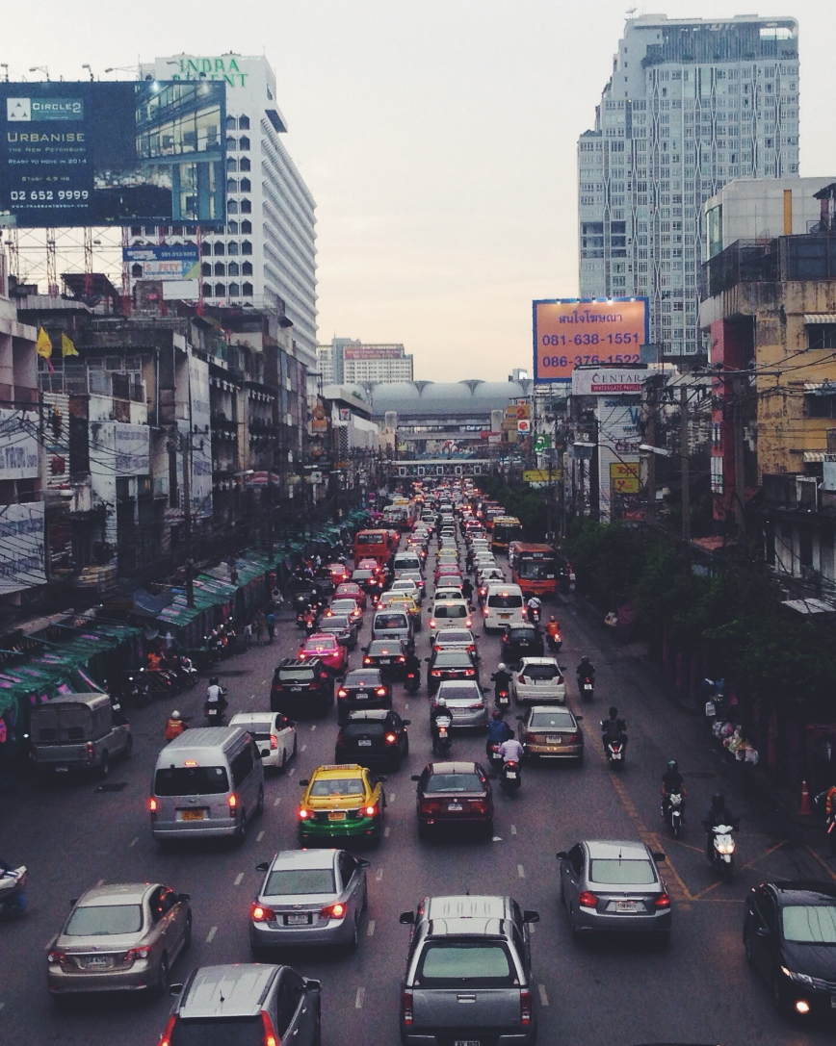
Why capacity restrictions?
The electrical grid has a limited capacity for transporting power
Try transferring too much power, and the system is at risk of collapse
Capacity restrictions are necessary to ensure stable electricity supply with high quality
Capacity restrictions are only one of the tools employed by the TSOs to ensure operational security

Slide 4
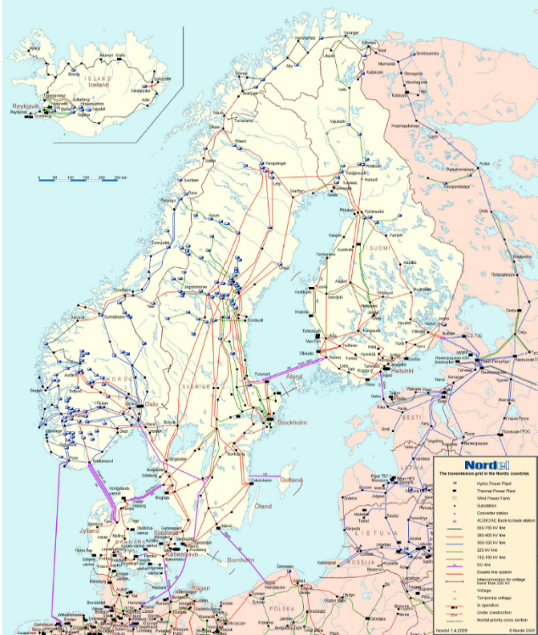
System Operator
Capacity Calculation
The physical world
The commercial world
Complexity
Simplicity
Detailed grid model
FB
CNTC
Capacity calculation is the process of translating the complex physical grid into a simplified form that can be understood and applied by the power exchange

Slide 5
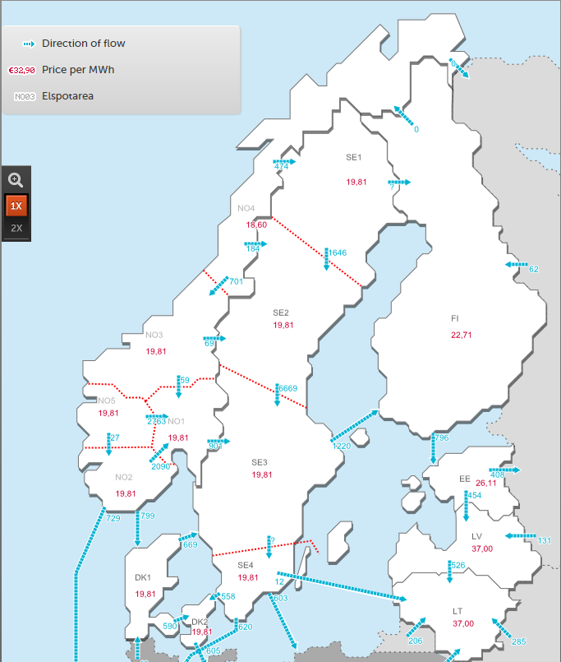
Market Operator
Capacity Allocation
Bids
Buy
Sell
Optimization
Prices, Net Positions => Scheduled flows
Capacities (constraints)
Capacity allocation is the process of maximizing social welfare, whilst respecting the physical constraints of the power system

Slide 6
Transit flows of one bilateral exchange
Trade
0.1 %
FB
12 %
0.1 %
20 %
8 %
12 %
56 %
Flow factor (PTDF)
24 %
24 %
0 %
0.7 %
0.7 %
0.7 %
24 %
Flow factor
Commercial Flow (NTC)
Commercial Exchange

Slide 7
Capacity calculation – (C)NTC
Capacity is provided as MW limits on exchange on each BZ border
The market does not know real physics, and capacities are perceived as simultaneously available
=
Max injection of 2000 MW
Physical capacity
Exchange capacity
Max injection of 1500 MW
Physical flow
Cannot provide the physical capacity on all lines at the same time because it allows for physical overloads
Exchange Capacities must be reduced
in order to maintain operational security
Exchange capacity
Physical flow
^{A}
^{B}
^{A}
^{B}
667 MW
500 MW
1000 MW
OK
750 MW
Not OK
1000 MW
1000 MW
750 MW
750 MW
1333 MW
667 MW
1000 MW
500 MW
^{C}
^{C}
Overload
Unutilized capacity
Max Extraction of 2000 MW
Max Extraction of 1500 MW
Market constraint: NP ≤ Σ_{∀j} CNTC_{j}

Slide 8
Flow based – PTDF, CNE & Fmax
100 MW
Capacity is provided by PTDFs, and CNEs with a MW limit/margin
The market knows a linearized version of the real physics and understands that capacities are interdependent
The lines (a-b), (b-c) and (a-c) are CNEs
The physical capacity for each line is provided (Fmax = 1000 MW)
The PTDFs shown are the flows induced on each line by a net injection in A and extracted in C (slack node), each BZ will have a unique PTDF on each CNE
The FB capacities constitute a simplified grid model to be applied by the power exchange
^{A}
33 MW
^{B}
PTDF_{A} = 33%
Fmax = 1000 MW
PTDF_{A} = 33%
Fmax = 1000 MW
Fmax = 1000 MW
PTDF_{A} = 67%
67 MW
33 MW
^{C}
100 MW

Slide 9
How bilateral exchanges are perceived by the market algorithm in FB and CNTC
CNTC
FB

Slide 10


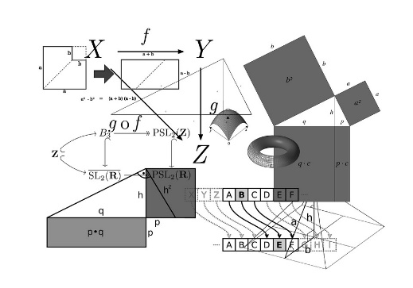

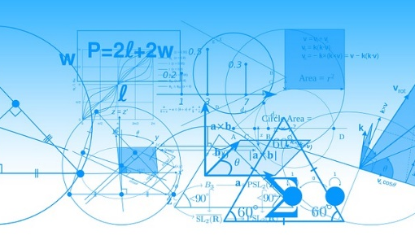








Nordic Capacity Calculation - Today
NTC
NTC
NTC
NTC

Slide 11


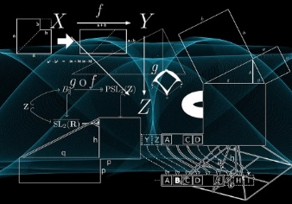

Coordinated Capacity Calculator (CCC)
FB / CNTC
Nordic Metodologies
Day-Ahead Capacities: Flow Based
Intraday Capacities: Flow Based
(CNTC as interim until XBID supports Flow Based)
Long-term Capacities: ACER decision
CCC
Input to capacity calculations

Slide 12













.. and Multiple NEMOs
?
FB / CNTC
CCC
Input to capacity calculations

Slide 13
Backup slides

Slide 14
Physical limitations and exchange capacity

Slide 15
Flow Based
Complexity
Simplicity
Detailed grid model
FB
CNTC
CNTC and FB describes physical transfer limitations of the power system
CNTC and FB are used as constraints in market allocation (exchange capacity)
FB describes the constraints in higher detail, which enables better optimization (larger domain)

Slide 16
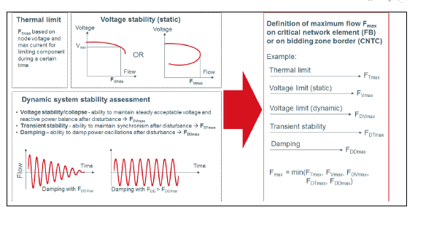
Complexity
Simplicity
Physical capacity
Detailed grid model
FB
CNTC
The physical capacity is defined by the components of the power-grid and the state of the power system
Due to operational security and risk considerations, the secure physical capacity applied in operation will/may differ from the maximum found in any given scenario
Thus, the secure physical capacities of grid components will vary with grid topology, temperatures, loading and risk assessment
The secure physical capacity is a common base for the FB and CNTC capacity calculation
The physical capacities constitute complex non-linear limitations on flows
  Thermal limitations for each grid element
  Steady state and dynamic voltage limits for each grid element or group of elements
  Dynamic stability limits for groups of grid elements
  Short circuit limits
  N-1 considerations

Slide 17
Complexity
Simplicity
Detailed grid model
FB
CNTC
Exchange capacity
Exchange capacity is derived from the secure physical capacity to provide MW limits for commercial power exchanges
Exchange capacity provides limitations for the electricity market, in terms of linearized constraints, on cross zonal exchanges. The linearized constraints are simplifications of the complex non-linear secure physical limitations of the grid
There are two options for providing exchange capacity for the electricity market:
  FB: The electricity market receives a linearized security domain described by power transfer distribution factors (PTDFs) on critical network elements (CNEs). The flow on each individual CNE is limited by a MW margin representing the secure physical capacity of the component(s), while the PTDF gives the flow on each CNE from a one MW injection in each BZ
  CNTC: The electricity market receives a MW limit on bilateral exchanges between bidding zones. The MW limits are derived from the security domain where bidding zone configuration is applied in order to capture all relevant limitations

Slide 18
How bilateral exchanges are perceived by the market algorithm in FB and CNTC
CNTC
FB

Slide 19
Capacity calculation - Example
Example
A power grid consisting of 3 bidding zones and three identical lines with the physical capacity of 1000 MW each – having equal impedances
^{A}
^{B}
Fmax = 1000 MW
Fmax = 1000 MW
Fmax = 1000 MW
Simplifying assumptions
No internal CNEs/grid constraints
Only one node in each bidding zone
The only CNEs are the tie lines
No reliability margin
No contingencies
No remedial actions
^{C}

Slide 20
Capacity calculation – (C)NTC
Capacity is provided as MW limits on exchange on each BZ border
The market does not know real physics, and capacities are perceived as simultaneously available
=
Max injection of 2000 MW
Physical capacity
Exchange capacity
Max injection of 1500 MW
Physical flow
Cannot provide the physical capacity on all lines at the same time because it allows for physical overloads
Exchange Capacities must be reduced
in order to maintain operational security
Exchange capacity
Physical flow
^{A}
^{B}
^{A}
^{B}
667 MW
500 MW
1000 MW
OK
750 MW
Not OK
1000 MW
1000 MW
750 MW
750 MW
1333 MW
667 MW
1000 MW
500 MW
^{C}
^{C}
Overload
Unutilized capacity
Max Extraction of 2000 MW
Max Extraction of 1500 MW
Market constraint: NP ≤ Σ_{∀j} CNTC_{j}

Slide 21
(C)NTC – Net Transfer Capacity
Capacity is provided as MW limits on exchange on each BZ border
The full set of CNTC values are referred to as a CNTC domain, there is an unlimited set of potential CNTC domains available
Complicated to manage in highly meshed grids with many BZs
Flow determination is not a part of the market coupling (comes after), and thus there might be large differences between scheduled and physical flows
^{A}
^{B}
NTC = 750 MW
Fmax = 1000 MW
NTC = 750 MW
Fmax = 1000 MW
Fmax = 1000 MW
NTC = 750 MW
^{C}

Slide 22
Flow based – PTDF, CNE & Fmax
100 MW
Capacity is provided by PTDFs, and CNEs with a MW limit/margin
The market knows a linearized version of the real physics and understands that capacities are interdependent
The lines (a-b), (b-c) and (a-c) are CNEs
The physical capacity for each line is provided (Fmax = 1000 MW)
The PTDFs shown are the flows induced on each line by a net injection in A and extracted in C (slack node), each BZ will have a unique PTDF on each CNE
The FB capacities constitute a simplified grid model to be applied by the power exchange
^{A}
33 MW
^{B}
PTDF_{A} = 33%
Fmax = 1000 MW
PTDF_{A} = 33%
Fmax = 1000 MW
Fmax = 1000 MW
PTDF_{A} = 67%
67 MW
33 MW
^{C}
100 MW

Slide 23
Flow Based Domain
^{A}
^{B}
^{C}
The "full" security domain is provided directly as capacity to the market in the form of PTDFs and CNEs with MW margins
The security domain is uniquely defined by the grid model
Features of FB
Allows for price differences between uncongested areas - increases the ability of the market to utilize all available capacity
The market coupling solves both net positions and flows and thus scheduled and physical flows are converging
The FB domain is uniquely defined
Line (CNE) | Max flow (Fmax) | PTDFs for BZ A | PTDFs for BZ B | PTDFs for BZ C (slack)
A -> B (CNE 1) | 1000 MW | 33 % | - 33 % | 0
B -> C (CNE 2) | 1000 MW | 33 % | 67 % | 0
A -> C (CNE 3) | 1000 MW | 67 % | 33 % | 0
FB capacities
The PTDFs are calculated by the CGM and thus depend on the impedances in the grid
In this setting, the security domain is often referred to as the FB domain

Slide 24
FB vs CNTC
NTC (1)
NTC (2)
FB
PTDFs
PTDFs
^{A}
750
^{B}
^{A}
0
^{B}
^{A}
1000
^{B}
750
750
1000
1000
1000
1000
^{C}
^{C}
^{C}
PTDFs
Max import/export in all BZs are 1500 MW
Max import/export in C is 2000 MW
Max import/export in A and B is 1000 MW
Max import/export in all BZs are 2000 MW (but not all at the same time)

Slide 25
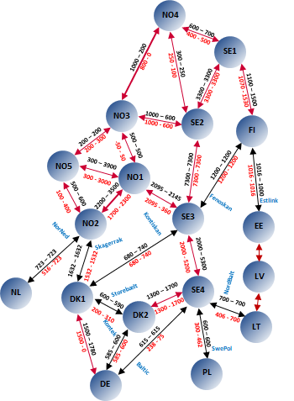
It gets slightly more complicated in the real world,……..
12 BZs in the Nordics + 14 more virtual BZ to manage the HVDCs
70-90 limiting CNEs monitored in both directions for every hour
Both internal and cross-zonal CNEs
Bidding Zones are not copper plates – net positions distribute within a BZ, why Generation Shift Keys are needed
Application of remedial actions, contingencies and reliability margins for all CNEs

