Slide 1
Enhanced TSO coordination for Europe
Joachim Vanzetta, Chair of the Board, ENTSO-E
RSC Conference, Copenhagen
08/10/2019

Slide 2
Seven pillars for enhanced TSO’ regional coordination by 2030
TSOs act locally, coordinate regionally and collectively think European.
Coordination services should grow in a flexible manner and going beyond legal requirements as needed.
The evolution of regional TSOs’ coordination should be pragmatic.
Strengthening the link between system and market operation is essential.
The Regional Coordination Centres (RCC) should build upon the positive structures of RSCs to TSOs.
TSOs’ regional coordination should have a suitable legislative and regulatory framework.
TSOs’ coordination should support a “European pathway” to maximize social welfare in partnership with stakeholders.
1
2
3
4
5
6
7
Notes:
TSOs act locally, coordinate regionally – within and across regions – and collectively think European. TSOs coordinate for the benefit of society at large.
The evolution of regional TSOs’ coordination should be pragmatic and follow an evolutionary approach, taking stock of lessons learned to resolve new challenges.
Strengthening the link between system and market operation is essential for a secure, sustainable, and cost-effective electricity supply in Europe.
The Regional Coordination Centres (RCC) should build upon the positive structures and services of RSCs to TSOs. Under the CEP, RCCs should address the capacity calculation regions (CCRs) and appropriately accommodate the future concept of System Operation Regions (SORs)*.
Coordination services should grow in a flexible, modular, and organic manner, addressing the needs for running CCRs and SORs and going beyond legal requirements as needed.
TSOs’ regional coordination should have a suitable legislative and regulatory framework and sufficient time to deliver the legally mandated tasks. Regional Energy Forums should support the evolution of TSOs’ coordination by providing policy alignment and perspective.
TSOs’ coordination should support a “European pathway” to maximize social welfare in partnership with DSOs and relying on close cooperation of all Member States, NRAs, EC, ACER, and other relevant stakeholders.

Slide 3
1993-2000
Nordic markets coupled
2000’s
Regional associations of TSOs established
2001
Balancing cooperation in the Nordics
2006-2010
Trilateral/ Pentalateral market coupling
2008
CORESO and TSC established
2009
ENTSOE established
2000-2015
Auction offices
2014
MRC Market Coupling
2019-2020:
EU coverage of RSCs
2005-2010
Germany and neighbours balancing cooperation
1990-1993
Energy market liberalisation & Single market comes into effect
1996
1st energy package
2003
2nd energy package
2009
3rd energy package
2019
4th energy package
2020-2030
Implementation
Evolution of TSO regional coordination

Slide 4
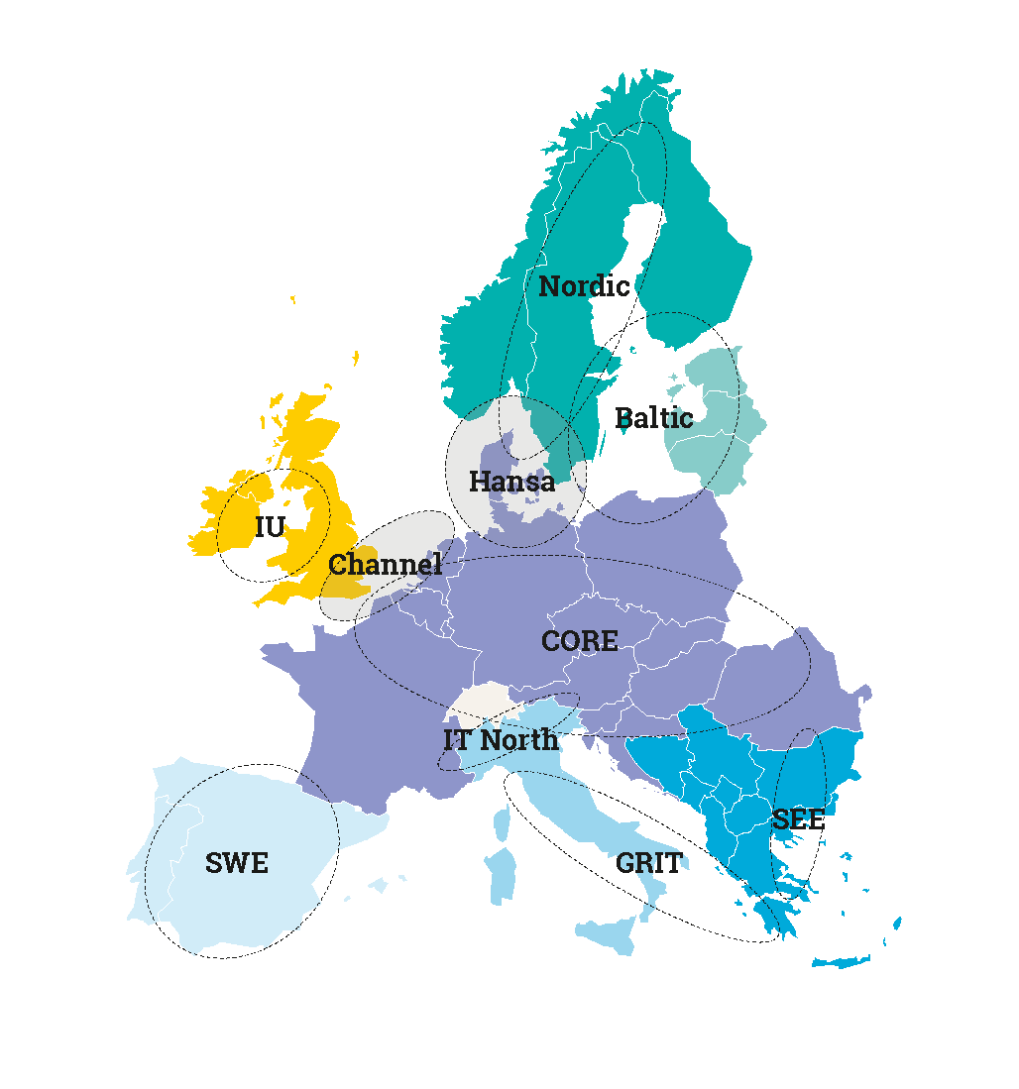
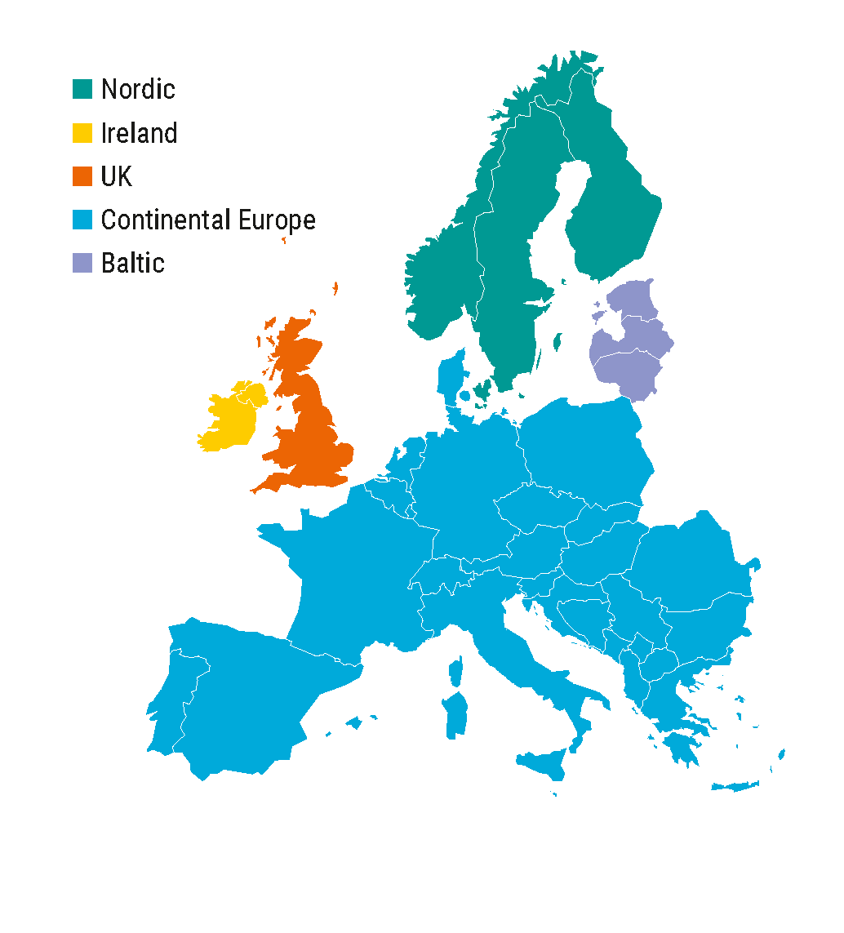
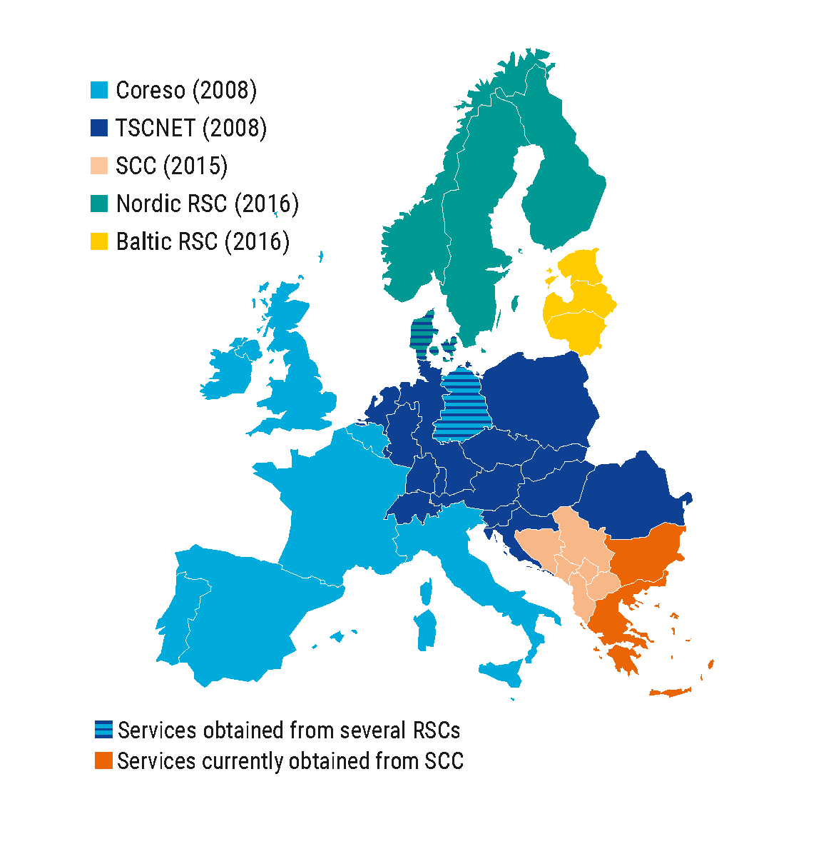
State of play of TSO regional coordination
10 CCRs
5 Synchronous Areas
5 RSCs
State of play of TSOs’ regional coordination in markets and system operations.

Slide 5




Recent developments towards an RSC/RCC in SEE region
MoU signed on 12/7/2019
MoU
Untill RCC establishment:
  ESO will provide CCC
  IPTO will provide CSA
Location TBD by November
Notes:
The CEOs of the three TSOs (ESO, IPTO and Transelectrica) signed on 12/7/2019 an MoU regarding the establishment of a common RCC
The MoU provides a framework for cooperation among the 3 TSOs with a common goal to find a mutually acceptable solution for establishing an RCC
According to the MoU, until the incorporation of the RCC, it has been decided that
ESO-EAD will provide Capacity Calculations and IPTO will provide Coordinated Security Analysis for the SEE CCR
All TSOs are working towards reaching an agreement for the location of the company by November and signing the required documents for the RCC incorporation, for the new company to start providing services within 2020
The MoU on the SEE RCC supports the TSOs in their commitment to strengthen regional cooperation ensuring the security and efficiency of the power system for the benefit of society and consumers

Slide 6
Timeline for major evolution of the CCRs

Slide 7
Evolution of regional coordinated
services
Timeline refers to entry into force and implementation of relevant network codes, all TSO decisions, and
CEP regulation.

Slide 8
Current roadmap for TSO regional coordination in markets & operations

Slide 9
THANK YOU FOR YOUR ATTENTION
www.entsoe.eu

