Slide 1
Take 1.5h to understand and see the TYNDP 2016 projects assessments results
Public webinar
09 May 2015

Slide 2
TYNDP 2016 projects assessments
Understanding the TYNDP 2016 results
When, where and on what you can give us your comments
Information on the next TYNDP 2018: CBA 2.0 and scenario
Questions and answers session

Slide 3
TYNDP2016
Felix Maire
Public webinar
projects assessments
09 May 2015

Slide 4
Draft results of the TYNDP 2016 projects assessments

Slide 5
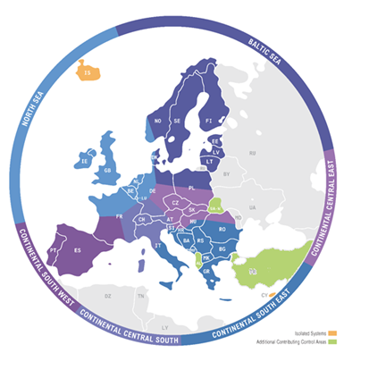
Objectives
Brief recall of process
Draft results

Slide 6
TYNDP2016 objectives
  Explore and explain a vision of the future power system
  Highlight investment needs based on coordinated regional planning studies
  Assess cost/benefits of projects of pan-European relevance in a transparent and non-discriminatory manner
  Provide data, assumptions, methodologies

Slide 7
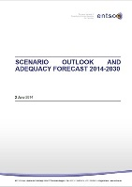


TYNDP2016 timeline
 |  | 2015 |  |  |  | 2016
Q3 | Q4 | Q1 | Q2 | Q3 | Q4 | Q1 | Q2 | Q3 | Q4
Scenario development
Scenario Development Report
Coordinated planning
Regional Investment Plans & draft list TYNDP2016 Project Candidates
Project identification
CBA assessments
Public consultation
Final TYNDP2016

Slide 8
Scenario building – framing the uncertainty
How will 2020 and 2030 look like?
What parameters to consider (demand, technology, policies)?
How to deal with inherent uncertainties?
On track towards 2050 RES objectives
2030
Weaker pan-E framework
Stronger pan-E framework
2020
Today
Delayed towards the 2050 RES objectives
The further you look, the more scenarios we need to ensure a robust study framework
One scenario
Four Visions
Access the TYNDP 2016 Scenario development report for more information on the scenarios.

Slide 9
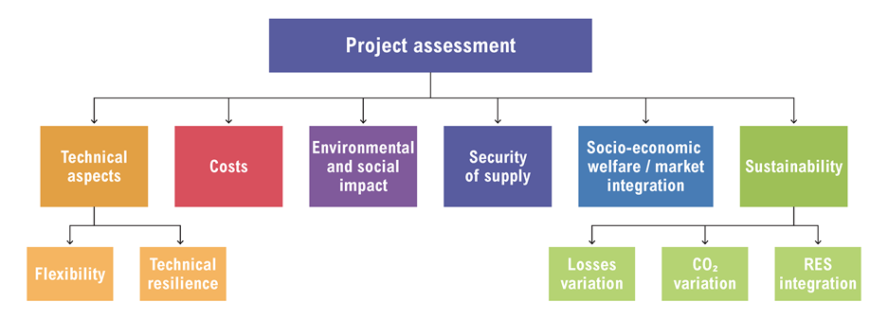
Assessment of individual projects
Indicators
Multi-criteria approach
Some criteria scenario-specific
Coordinated ENTSO-E study
Specific tailoring for storage projects
Based on scenario/project data available on ENTSO-E website
Approach
Put one IN at a Time (PINT)
B
B
A
C
A
D
B
C
A
D
C
Reference grid
D
Take One Out at a Time (TOOT)

Slide 10
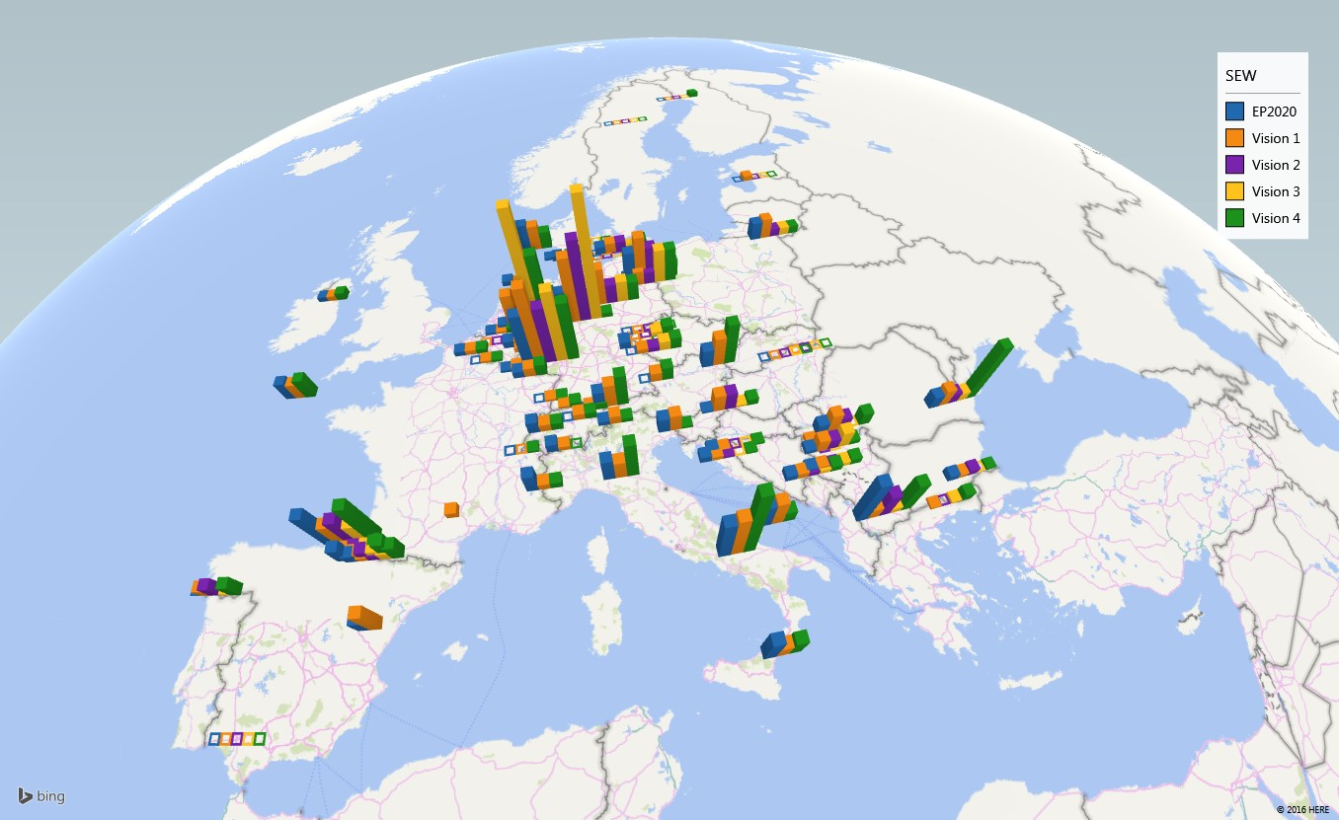
Draft assessment results – Social Economic Welfare
Does not cover here:
Connection projects
Projects promoted by non-ENTSO-E members
Some internal projects
Draft

Slide 11
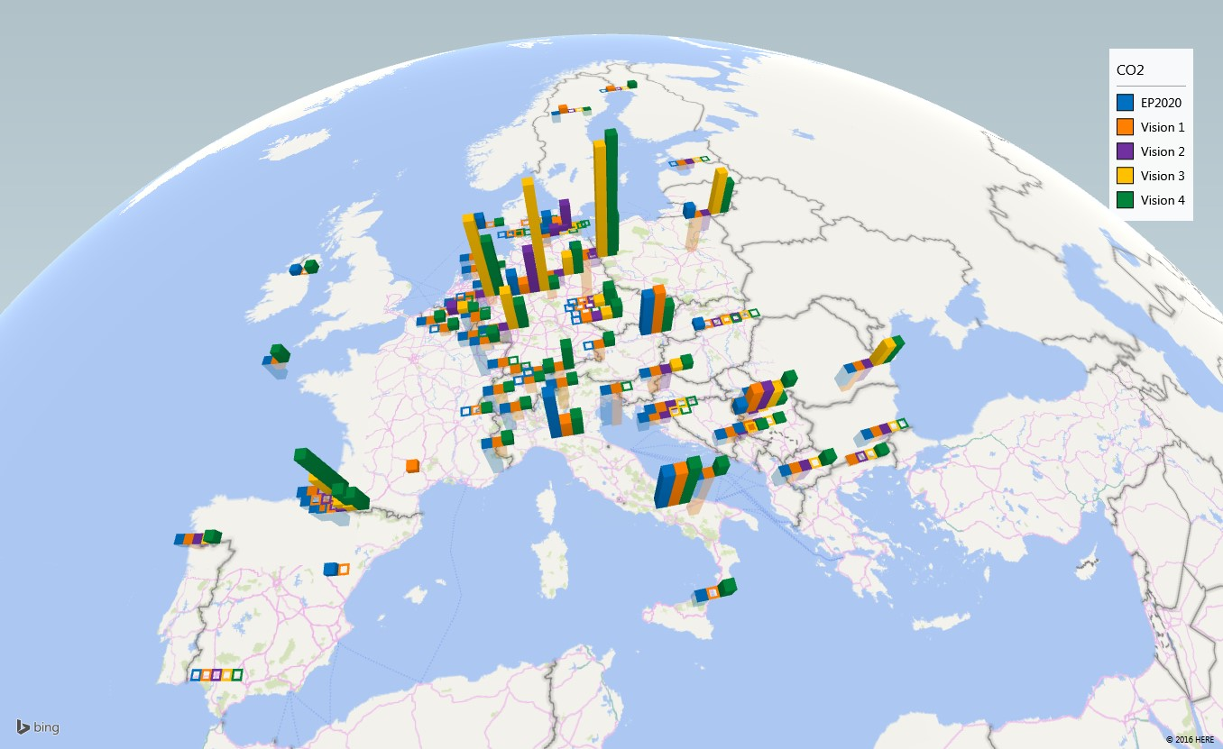
Draft assessment results – CO2 emissions
Does not cover here:
Connection projects
Projects promoted by non-ENTSO-E members
Some internal projects
Draft

Slide 12
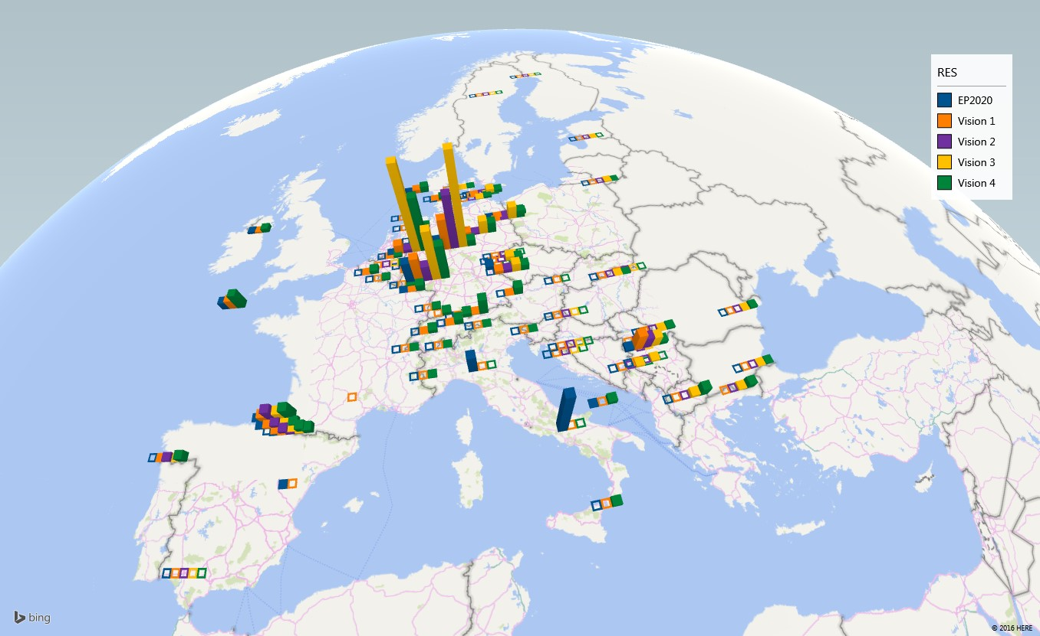
Draft assessment results – RES integration
Does not cover here:
Connection projects
Projects promoted by non-ENTSO-E members
Some internal projects
Draft

Slide 13
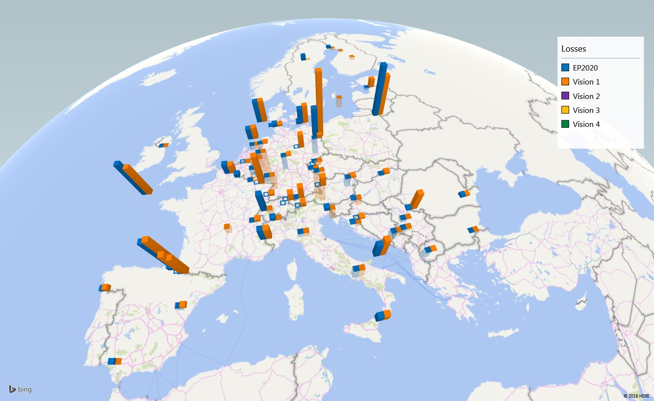
Draft assessment results – Losses
Does not cover here:
Connection projects
Projects promoted by non-ENTSO-E members
Some internal projects
Draft

Slide 14
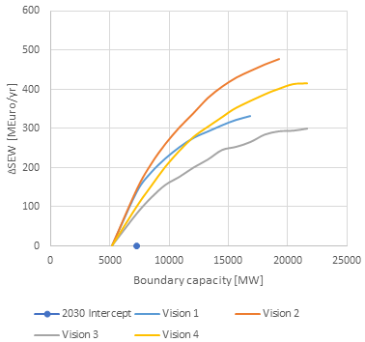
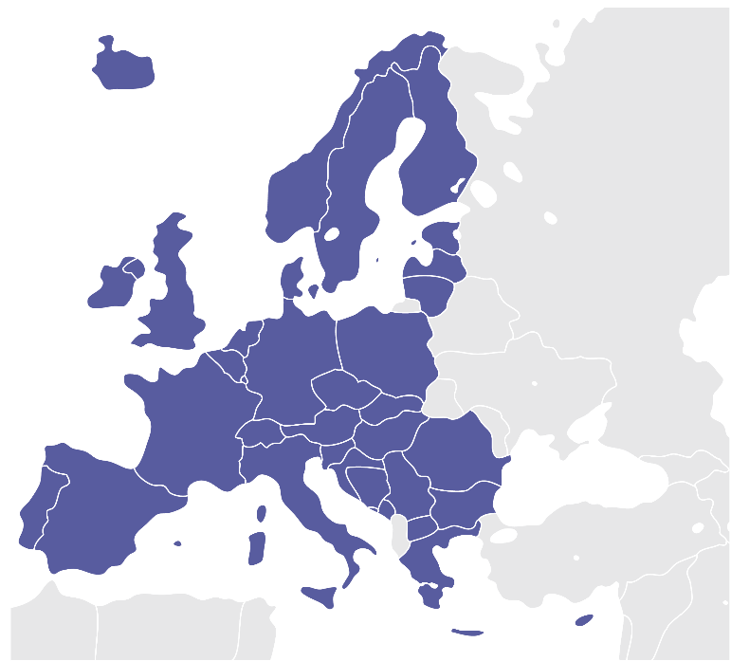
Capacity analysis
Example: Nordic boundary
New complementary analysis performed in TYNDP 2016
Provides a view on relation between capacity and social economic welfare at specific boundaries
Draft
Notes:
Market based capacity analysis performed in the TYNDP2016 show the need to increase the interconnection capacity between the Nordics and the Continental system. In the SEW/GTC-curve we can see that the increase from todays capacity to the 2030-level is having a large SEW-value for all the scenarios. This is also one of the reason for the NordLink between Norway and Germany being realised. At the same time there is a need for having attention to the assumptions of TYNDP 2016. Bringing CO2, oil- , gas-, coal-prices down to 2016-level will influence the SEW-values of projects like NordLink in a negative direction.
Having a look at SEW/GTC-values of the different Visions indicates that the energy-balance of the different Visions both for the Nordics and Continental countries are the main driver for price differences and hence SEW-values. Eg. the Nordic surplus is very high in Vision 2, which gives a high price difference and hence high SEW/GTC-values.
NordLink will increase the capacity between the Nordics and the Continent by 1400 MW.

Slide 15
Publications by the Summer
Already published
TYNDP scenario development report
TYNDP 2016 list of projects
Six Regional Investment plans
Maps
Maps shows the location of the project, the voltage and the technology.
Project Sheets
The projects sheet add descriptive context to each project
Executive summary
Outlines the overall key messages of the TYNDP 2016
Insight Reports
Informative reports in the TYNDP
Short report focused on key messages
Includes regional focus on relevant boundaries
The insight reports add modularity to TYNDP. Here topics are broken down into segments. This allows readers to focus on areas of personal interest.
The Insight reports are split into ‘Topics’ and ‘Regions’

Slide 16
Project Sheets
The purpose of the project sheets is to build a story around project. The project sheets will be more comprehensive than those in TYNDP 2014 and cover a wider scale of topics.
The Topics which the project sheets will cover are;
Project Description
Investment Needs
Project CBA

Slide 17
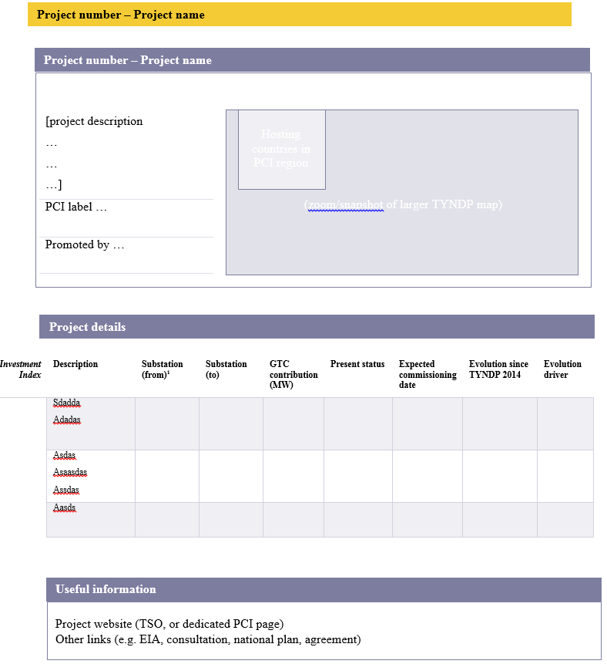
Project Sheet - Project Description
  In general this is the description of the project and it’s present status (including any evolution since TYNDP 2014).
  Promoters can include ‘useful information’ such as project website and clustering information

Slide 18
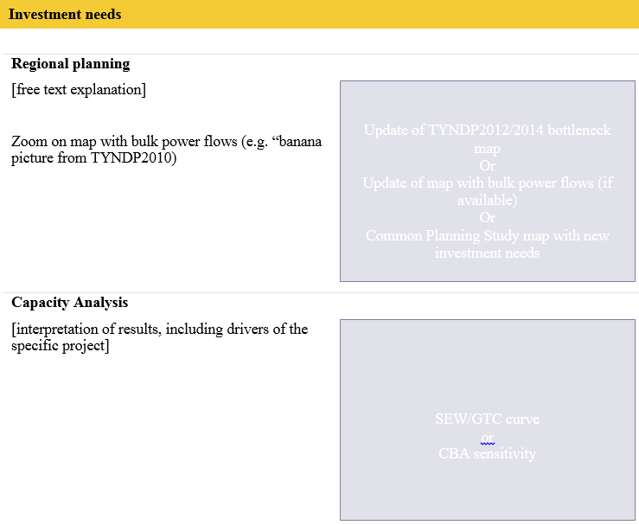
Project Sheet - Investment Needs
  Provides a narrative around each project
  outlines investment needs
  Will include a SEW/GTC curve and will illustrate how project relates (how Capacity relates to SEW)

Slide 19
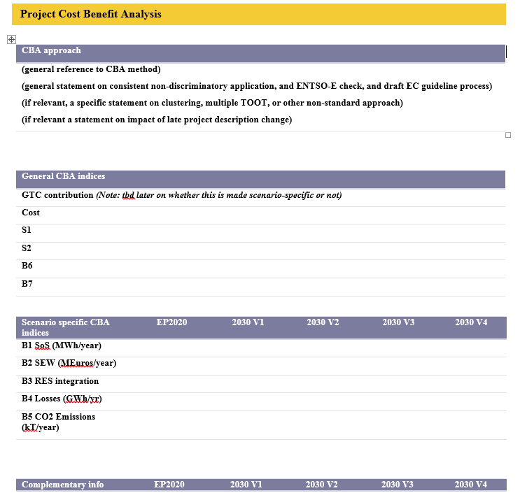
Project Sheet – Project CBA
  CBA approach (methodology)
  General CBA indices (e.g. GTC contribution in 2030)
  Specific Scenario CBA Indices
  Interpretation/Explanation of CBA Results

Slide 20
Stakeholder’s interaction TYNDP2016
Information on where, when and on what
Irina Minciuna
Public webinar
09 May 2015

Slide 21
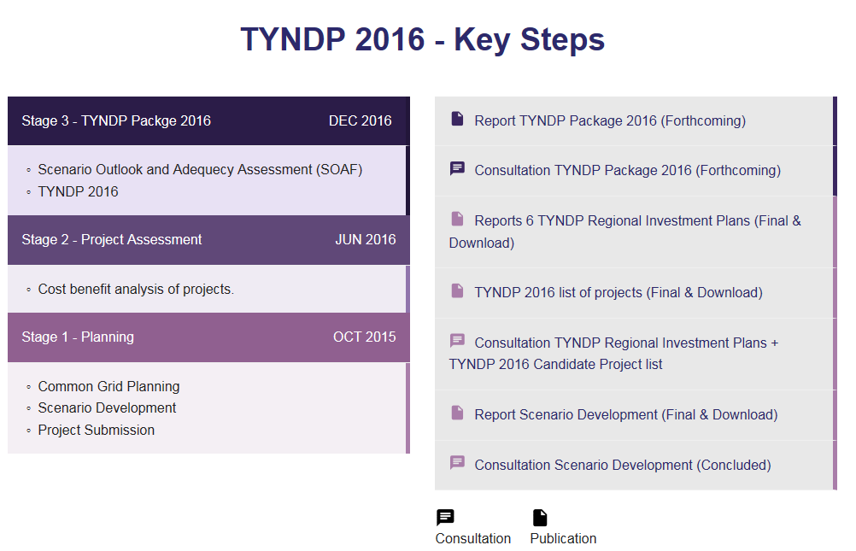




Spring 2017- Submission of projects in the PCI process
Dec 2016 – publication of the final TYNDP 2016
Oct 2016 – updated TYNDP 2016 submitted for ACER opinion
Oct 2016 - public webinar Explain the changes done in the TYNDP due to the stakeholders’
feedback
23 June - 9 Sept 2016 release of the TYNDP 2016 for consultation

Slide 22
TYNDP2018
Insight in the upcoming work and stakeholders’ interaction
Irina Minciuna
Public webinar
09 May 2015

Slide 23




The work on the 2018 has started
Drafting the TYNDP
Dec 2018
Final
TYNDP 2018
Define the assessment methodology – CBA 2.0
started
Define the main principles for the TYNDP 2018
Planning exercise and projects assessment:
Identification of needs
Submission of projects
Projects assessment
started
Frame the future
Scenarios development
Page 23

Slide 24
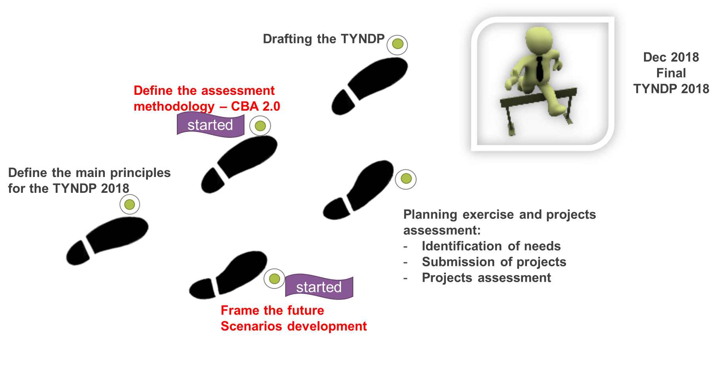
CBA 2.0 methodology
      16 March 2016 – Public workshop to explain the improvements and the get the first feedback
      25 April – 31 May – public consultation on the draft CBA 2.0
      10 July 2016 - public webinar CBA 2.0 – what we implemented or not from the stakeholders feedback
Sept 2016 – expected official ACER opinion
Sept –October 2016– refinement of the CBA based on the received feedback
      Oct – Nov 2016 - EC and MSs consultation
Dec 2016 - submission to EC for the official EC approval
By end Spring - EC approval of the final CBA 2.0 and publication in the official Journal

Slide 25
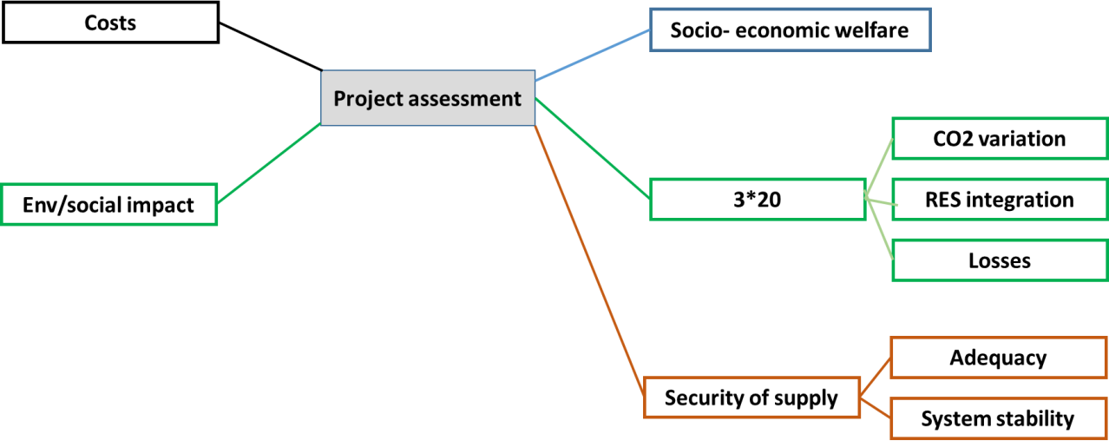
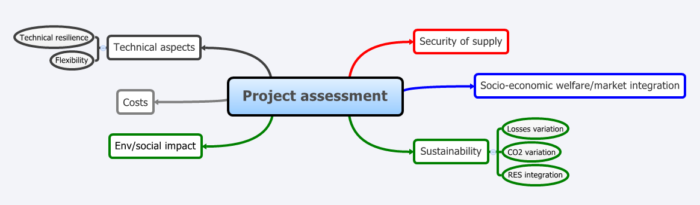
Going from 1.0 to 2.0 CBA
CBA 2.0
CBA 1.0

Slide 26
CBA 2.0 – main changes in indicators

Slide 27
Tyndp 2018 scenarios development
      12 May- 12 June– public web based consultation aiming to define the scenarios assumptions
      2 June - public workshop - aimed to get the first input on scenarios frame
      Next steps still to be defined- expected :
        Interaction on the methodology for scenario development
        Interaction on the scenario data
        Interaction on the draft reports

Slide 28
Overview of the stakeholders’ interaction within the TYNDP 16-18 period May – Sept 2016
23 June – 9 Sept TYNDP 2016 consultation
Oct 2016 public webinar on the comments received
Possibly another workshop/webinar in December
TYNDP 2016
25 April – 31 May
CBA 2.0 methodology – public web based consultation
12 May – 12 June
TYNDP 2018 public consultation scenarios assumptions
2 June
TYNDP 2018 scenarios assumptions public workshop
Over summer TYNDP 2018 principles – public web consultation
10 July 2016 - public webinar CBA 2.0
TYNDP 2018

Slide 29
TYNDP website
https://www.entsoe.eu/major-projects/ten-year-network-development-plan/Pages/index.html

Slide 30
Thank you for your attention
  http://www.entsoe.eu
  tyndp@entsoe.eu

