Slide 1
CBA 2.0
Public webinar on
Improving the pan-European cost-benefit analysis methodology
Public webinar
11th JULY 2016

Slide 2
25 April – 31 May – public consultation on the draft CBA 2.0
ENTSO-E received feedback from 19 consultants and additional input from ACER
General questions:
mostly positive feedback (it has been noticed that a system-wide and consistent CBA is a very complex task, but the ENTSO-E guideline does in general a good job)
however, improvements especially on clarity and explanation would be welcome
most general suggestions for improving the CBA are related to better explain special tasks
Our general answers:
we put our emphasis on answering specific questions which also helps to clarify some general aspects
some comments were related to case specific tasks which are not aimed to be content of a CBA guideline

Slide 3
Structural changes
Nils Schindzielorz
Public webinar
11 July 2016

Slide 4
Changes in the structure
Chapter in CBA 1.0 | Changes in CBA 2.0
1 Introduction and scope | -
1.1 Transmission system planning | -
1.2 Scope of the document | -
1.3 Content of the document | -
2 Scenarios and planning cases | Renamed in Scenario- and Grid Development
2.1 Scope of scenarios | Included in introduction Chapter 2
2.2 Content of scenarios | Chapter 2.1
2.3 Technical and economic key parameters | Deleted
2.4 From scenarios to planning cases | Deleted and integriated in other chapters
2.5 Multi-case analysis | Chapter 2.2
3 Project assessment: combined cost benefit and multi-criteria analysis | -
3.1 Project identification | Deleted
3.2 Clustering of Projects | Chapter 3.1
3.3 Assessment framework | Chapter 3.2
3.4 Grid Transfer Capability calculation | Chapter 3.3

Slide 5
Changes in the structure
Chapter in CBA 1.0 | Changes in CBA 2.0
3.5 Cost and environmental liability assessment | Chapter 3.4
3.6 Boundary conditions and main parameters of benefit assessment | Chapter 3.5
3.7 Methodology for each benefit indicator | Chapter 3.6
3.8 Overall assessment and sensitivity analysis | Chapter 3.7
4 Technical criteria for planning | Moved to annex; Annex 1
4.1 Definitions | Moved to annex; Annex 1
4.2 Common criteria | Moved to annex; Annex 1
5 Annex 1: Impact on market power | Annex 4
6 Annex 2: Multi-criteria analysis vs cost benefit analysis | Annex 5
7 Annex 3: Total surplus analysis | Annex 6
8 Annex 4: Value of lost load | Annex 7
9 Annex 5: Assessment of ancillary services | Annex 8
10 Annex 6: Assessment of storage | Chapter 4; Moved from annex
11 Annex 7: Environmental and social impact | Annex 9

Slide 6
Changes in the structure
Chapter in CBA 1.0 | New in CBA 2.0
- | New: Preamble “General definitions”
- | New: Annex 2 “Assessment of Internal Projects”
- | New: Annex 3 “Example of GTC calculation”

Slide 7
Changes from CBA 1.0 to CBA 2.0
Martti van Blijswijk
Public webinar
11 July 2016

Slide 8
General Definitions
Section in CBA 1.0: -
Section in CBA 2.0: Preamble
What is changed?
A new chapter “General definitions” is added.
Why is it changed?
The new chapter offers more clarity.
Changes after consultation:
Definitions aligned to TYNDP (Investment, Project)
Definition of and differentiation between GTC and NTC
According to comment(s) from consultations

Slide 9
Scenarios and planning cases
Section in CBA 1.0: 2
Section in CBA 2.0: 2
What is changed?
Some text elements are deleted or edited in order to streamline the scenario chapter.
Why is it changed?
Scenarios are decided within the TYNDP frame.
This chapter only reflects the need of scenarios within the CBA process
Changes after consultation:
Included a short abstract on sensitivities (shortened compared to CBA 1.0)
According to comment(s) from consultations

Slide 10
Project identification
Section in CBA 1.0: 3.1
Section in CBA 2.0: -
What is changed?
The chapter “Project identification” is deleted.
Why is it changed?
The starting point of CBA is that projects are already identified.
Changes after consultation:
no changes

Slide 11
Market and Network Studies
Section in CBA 1.0: 2.4.1
Section in CBA 2.0: 2.2
What is changed?
no major changes before the consultation
Changes after consultation:
Renamed to „Modelling Framework“ and included abstracts for Redispatch and Flow-Based simulations
According to comment(s) from consultations

Slide 12
Indicator categories
Section in CBA 1.0: 3.3
Section in CBA 2.0: 3.2 / 3.5

Slide 13
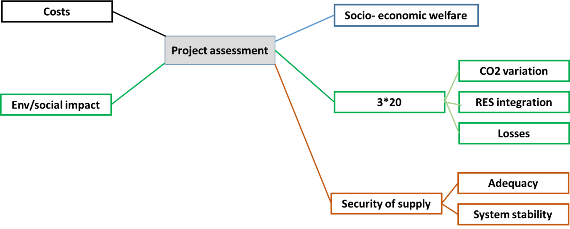
Indicator categories in CBA 2.0 pre consultation
Why is it changed?
SoS changed for more clarity and further possible development of the security of supply.

Slide 14
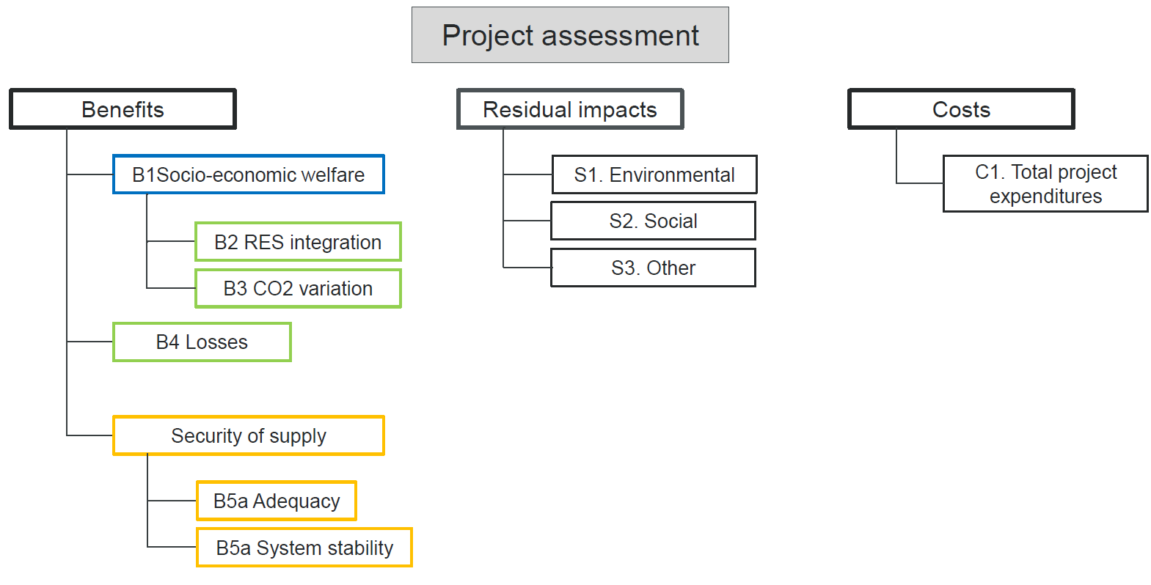
Indicator categories in CBA 2.0 post consultation
Why is it changed?
Regrouping into three main categories: Benefit, Costs, Residual impacts
Grouped RES and CO2 under SEW
According to comment(s) from consultations

Slide 15
Additional residual impact indicator: ‘S3. Other’
Section in CBA 1.0: -
Section in CBA 2.0: 3.2 / 3.5
Changes after consultation
A new residual impact indicator is introduced (S3. Other impacts), to allow for the reporting of impacts that are not captured by the calculation methodologies for S1 and S2 (which are in the unit ‘# of km’).
According to comment(s) from consultations

Slide 16
Clustering
Section in CBA 1.0: 3.2
Section in CBA 2.0: 3.1
What is changed?
20% and 5-years rules were replaced by a status-based approach.
Why is it changed?
The principles are the same, but complexity is reduced.
Outcomes (i.e., sets of investments that can or cannot be clustered into a project) are equivalent to the intended effects of the old rules.
Changes after consultation:
seperated the status „design&permitting“ into two seperate indicators to be consistent with the TYNDP

Slide 17
Security of supply, robustness, resilience
Section in CBA 1.0: 3.3
Section in CBA 2.0: 3.2
What is changed?
Security of supply, robustness, resilience were merged into adequacy and system stability.
Included the possibility to monetise SoS also by monetisation of avoided generation
Why is it changed?
More clarity regarding the components that should be understood under “security of supply„.
First step towards further development of the system stability component of security of supply.
Changes after consultation:
Rewritten the part on EENS related to the „adequacy margin“ make it more clear
Included an abstract on the possibility of monetisation of EENS by use of VOLL
According to comment(s) from consultations

Slide 18
In CBA 1.0 the challenges of SoS were reported in two different indicators
System Security
Adequacy
Indicator overview of CBA 1.0

Slide 19
In CBA 2.0 the SoS indicator includes both elements – Adequacy and system stability

Slide 20
Flexibility
Section in CBA 1.0: 3.7.7
Section in CBA 2.0: -
What is changed?
The part about flexibility is deleted and partially included in SoS – System security
Why is it changed?
The revision avoids misunderstanding:
In CBA 1.0 “flexibility” referred to the usefulness of the projects across different visions.
in CBA 2.0 “flexibility” is defined as the ability of a storage project to contribute to smoothen load and generation patterns.
Changes after consultation:
no major changes

Slide 21
Losses
Section in CBA 1.0: 3.3
Section in CBA 2.0: 3.2
What is changed?
The rules for the perimeter are better described.
Monetization rules are added.
Why is it changed?
The assessment is more consistent.
The monetization is demanded.
Changes after consultation:
no major changes

Slide 22
Costs
Section in CBA 1.0: 3.5
Section in CBA 2.0: 3.4
What is changed?
The costs should be reported according to the project status.
Each project promoter has to define a complexity factor in an early stage of development.
An explanation for the chosen complexity factor is demanded.
Why is it changed?
The revision is more consistent.
The complexity factor leads to clarification and transparency in case true costs differ from investment to investment.
Changes after consultation:
„best estimate“ costs also possible for projects under planning status
more guidance on complexity factor
According to comment(s) from consultations

Slide 23
Costs – Complexity factor
Each project promoter is recommended to consider the following when choosing the complexity factor: terrain, routing, presence of historical landmarks, presence of other infrastructure, population density, special materials and designs, protected areas, etc.
Several comments from the consultation were asking for more guidance on how to determine the factor
However a strict numerical interrelation between each single category and the complexity factor is a very complex task and should be carried out in the explanation of the value of the complexity factor by the project promoters.
a set of unit cost will be defined by ENTSO-E inside the relevant study (e.g. TYNDP), possibly taking advantage of the work already done by ACER for proposing unit cost according to the regulation 374/2013

Slide 24
GTC calculation
Section in CBA 1.0: 3.4
Section in CBA 2.0: 3.3
What is changed?
The calculation is better explained (including detailed example).
Why is it changed?
The revision ensures consistency.
Changes after consultation:
clear distinction between GTC and NTC by the different aspects of market- and physical flows
Included the hint that the GTC-calculation could have a big potential for uncertainties
According to comment(s) from consultations

Slide 25
Time frame
Section in CBA 1.0: 3.6.2
Section in CBA 2.0: 3.6.2
What is changed?
The paragraph “Time frame” is shifted under the paragraph “discount rate” (heading title changed to “Project NPV calculation” after consultation)
Why is it changed?
This is a more logical position in the text.
Changes after consultation:
no changes

Slide 26
Discount rate
Section in CBA 1.0: 3.6.3
Section in CBA 2.0: 3.6.2
Changes after consultation
The title “Discount rate” is converted in “project NPV calculation”.
The life-cycle is changed from 25 to 40 years.
Deleted the text related to different discount rates in different regions
Why is it changed?
The title did not fully cover the content.
It was already mention in the text, that the lifecycle of a typical transmission project is around 40 years.
According to comment(s) from consultations

Slide 27
Benefit analysis
Section in CBA 1.0: 3.6.4
Section in CBA 2.0: 3.6.3
What is changed?
TOOT and PINT are better explained.
In addition to the strict application of TOOT the project promoters may now provide information about the benefits of their projects in relation to a difference reference network.
Why is it changed?
The revision delivers more information.
The strict application of TOOT leads sometimes to results that do not reflect the true contribution of a project.
Changes after consultation:
no changes

Slide 28
Sensitivity analysis
Section in CBA 1.0: 3.8
Section in CBA 2.0: 2.4
What is changed?
The paragraph was deleted.
Why is it changed?
Sensitivity analysis (need for ~, extent of ~, etc.) is not part of the methodology, but a matter of consideration for each specific study.
Changes after consultation:
Re-included a changed, shorter and more general description
According to comment(s) from consultations

Slide 29
Overall assessment
Section in CBA 1.0: 3.8.1
Section in CBA 2.0: 3.8
Changes after consultation:
Deleted the figure and replaced it by a description
The figure did not give the desired additional information which is now given in text.
According to comment(s) from consultations

Slide 30
Technical criteria for planning
Section in CBA 1.0: 4
Section in CBA 2.0: Annex 1
What is changed?
The chapter is moved to the annex.
Items related to project identification are deleted.
Why is it changed?
The paragraph provides background information.
CBA deals with project assessment (not with identification).
Changes after consultation:
no changes

Slide 31
Assessment of storage
Section in CBA 1.0: Annex 6
Section in CBA 2.0: 4
What is changed?
The chapter is moved from the annex.
The flexibility indicator is added.
Why is it changed?
An own chapter for storage was demanded.
This is an outcome based on common work with storage promoters.
Changes after consultation:
Included the new „S.3 Other impacts“ indicator

Slide 32
CBA 2.0
Next steps
Irina Minciuna
Public webinar
Improving the pan-European cost-benefit analysis methodology
11 July 2016

Slide 33
CBA 2.0 methodology – next steps
16 March 2016 – Public workshop to explain the improvements and the get the first feedback
25 April – 31 May – public consultation on the draft CBA 2.0
11 July 2016 - public webinar CBA 2.0 – what we implemented or not from the stakeholders feedback
October 2016 – expected official ACER opinion
October – first part of November 2016– refinement of the CBA based on the received feedback
Nov- Dec 2016 - EC and MSs consultation
Dec 2016 - submission to EC for the official EC approval
By end Spring - EC approval of the final CBA 2.0 and publication in the official Journal
Thank you for your input!

Slide 34
Irina Minciuna
irina.minciuna@entsoe.eu

